Slide 1
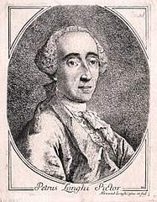
PIETRO LONGHI
Pietro Longhi, 1702 vagy 1701.– 1785. velencei festő

Slide 2
FESTMÉNYEK

Slide 3
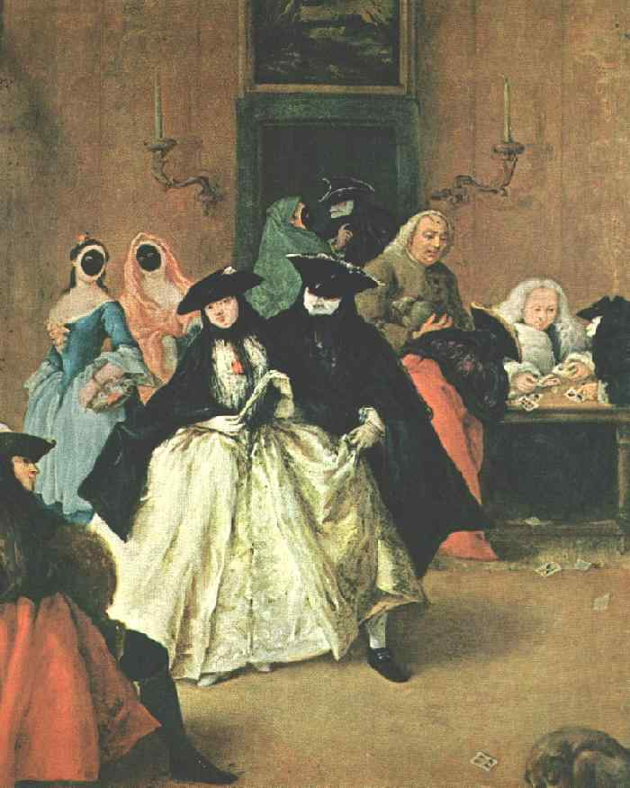
Pietro Longhi
The Ridotto 1740's Oil on canvas Raccotta Salon
Venice

Slide 4
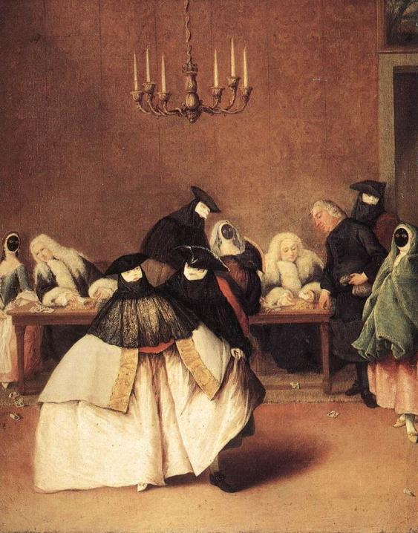
Pietro Longhi
Il Ridotto 1740s Oil on canvas Accademia Carrara Bergamo

Slide 5
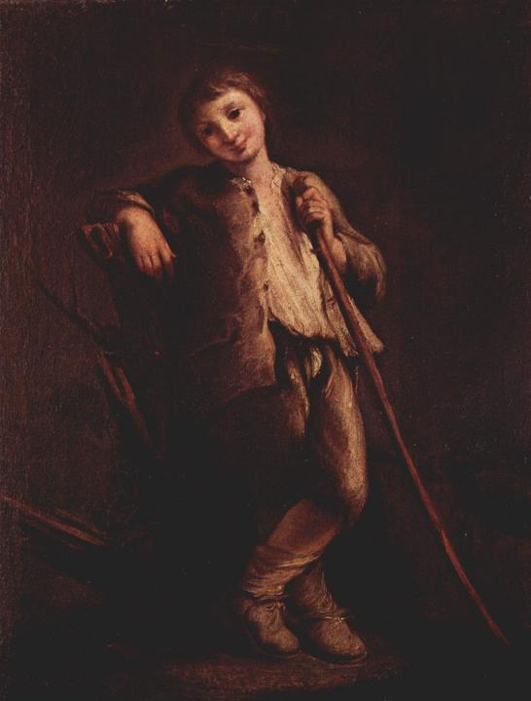
Pietro Longhi
Shepherd boy
circa 1740
Oil on canvas
61 x 48 cm
Museo Civico, Bassano

Slide 6
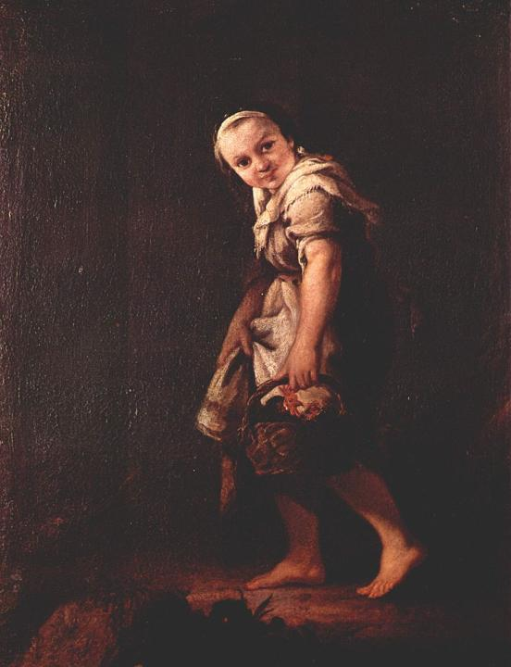
Pietro Longhi
Shepherd girl with a basket
circa 1740
Oil on canvas
61 x 48 cm
Museo Civico, Bassano

Slide 7
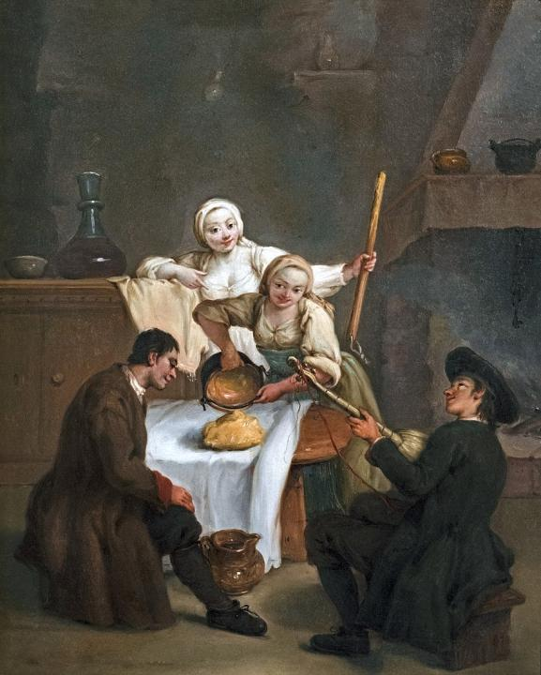
Pietro Longhi
La Polenta
1740
Oil on canvas
61 x 50 cm
Longhi Room
Ca' Rezzonico, Venice

Slide 8
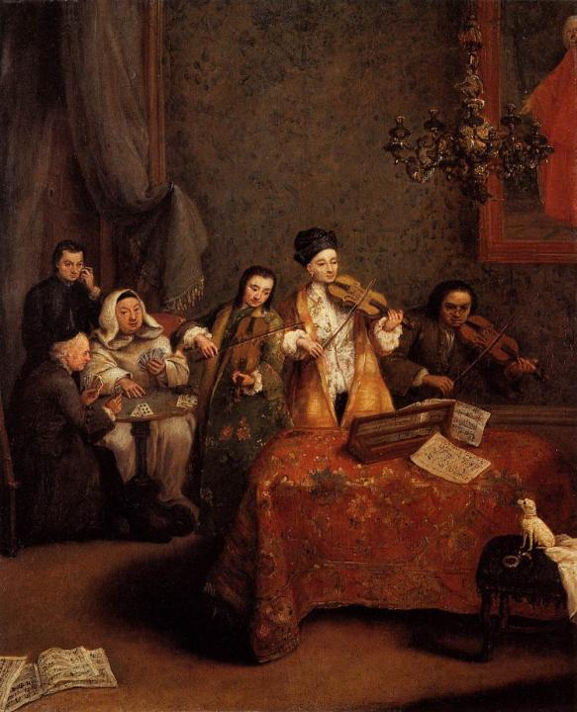
Pietro Longhi
The Concert 1741 Oil on canvas
60 x 48 cm Gallerie dell'Accademia Venice

Slide 9
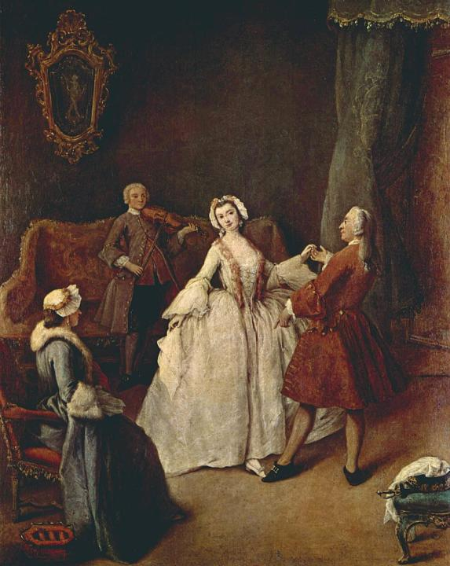
Pietro Longhi
The Dancing Lesson c. 1741 Oil on canvas
61 x 51 cm Gallerie dell'Accademia
Venice

Slide 10
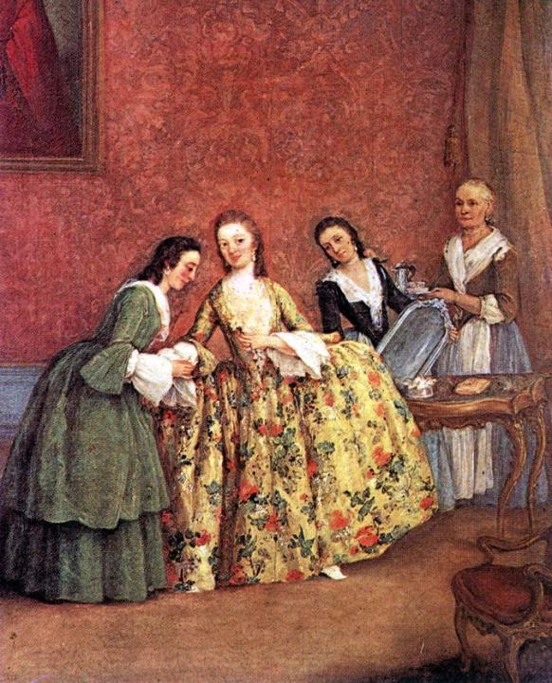
Pietro Longhi
The Venetian Lady's Morning c. 1741 Oil on canvas
60 x 49 cm Gallerie dell'Accademia, Venice

Slide 11
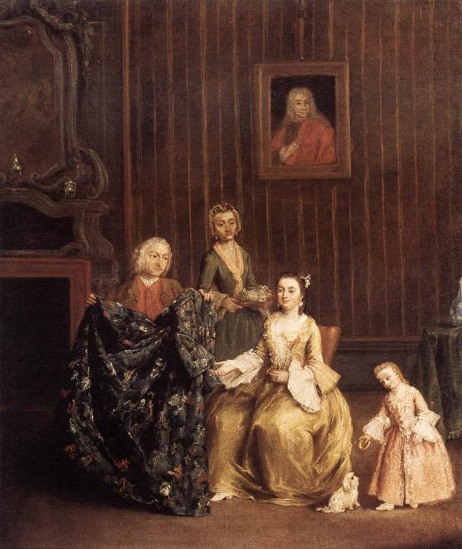
Pietro Longhi
The Tailor 1741 Oil on canvas Gallerie dell'Accademia Venice

Slide 12
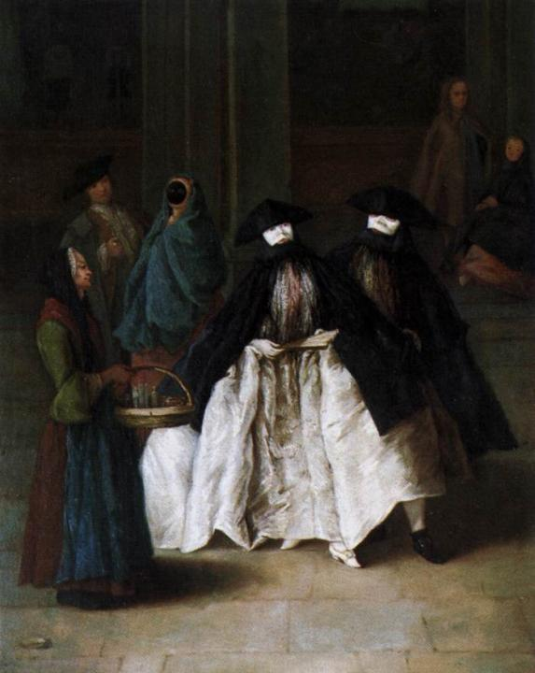
Pietro Longhi
The Scent-Seller c. 1741 Oil on canvas Museo del Settecento Veneziano, Ca' Rezzonico Venice

Slide 13
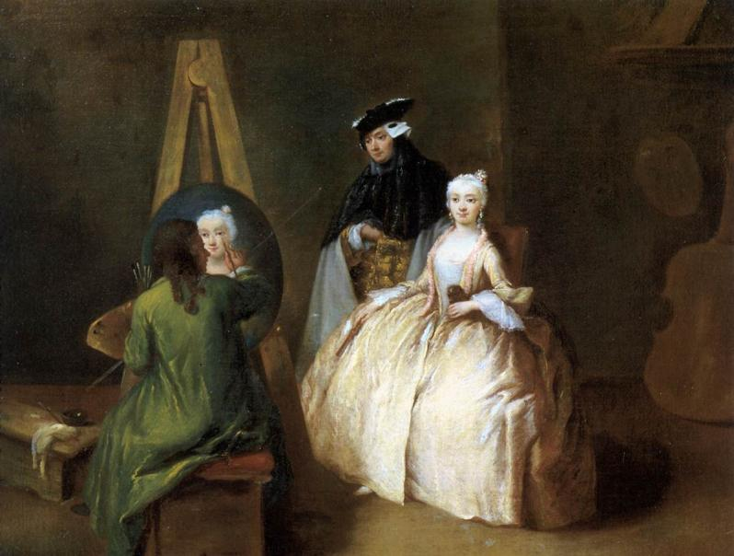
Pietro Longhi: Painter in his Studio, 1740-45, Oil on canvas Museo del Settecento Veneziano, Ca' Rezzonico, Venice

Slide 14
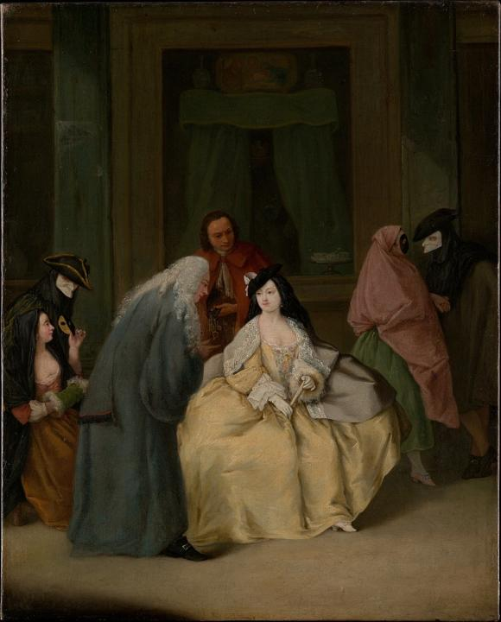
Pietro Longhi
The Meeting
1746
Oil on canvas
61 x 49.5 cm
The Metropolitan Museum of Art
New York

Slide 15
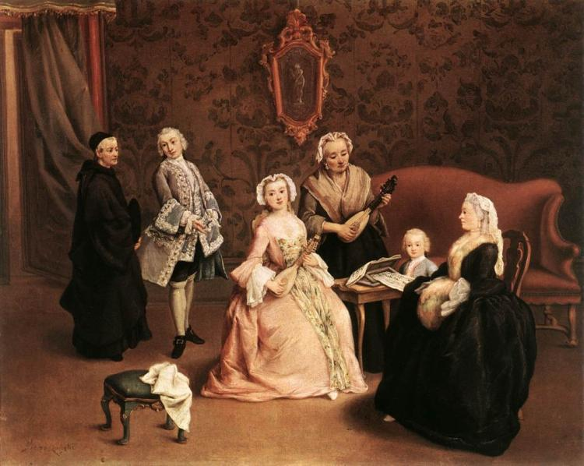
Pietro Longhi: The Little Concert, 1746, Oil on canvas, 50 x 62 cm Pinacoteca di Brera, Milan

Slide 16
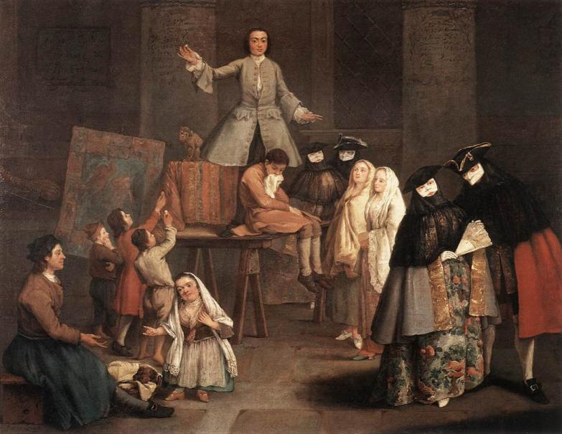
Pietro Longhi: The Tooth Puller, 1746, Oil on canvas, 50 x 62 cm Pinacoteca di Brera, Milan

Slide 17
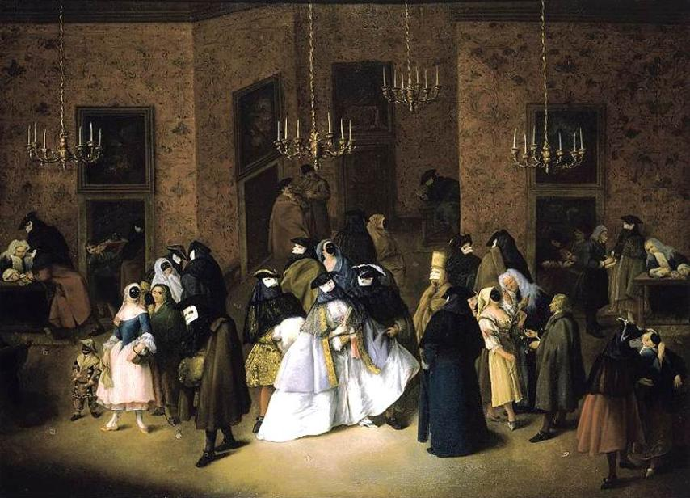
Pietro Longhi: The Ridotto in Venice, 1750's, Oil on canvas
84 x 115 cm, Private collection

Slide 18
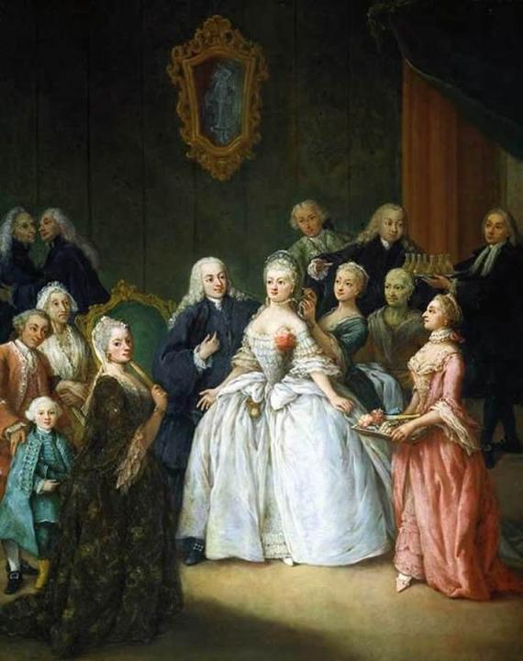
Pietro Longhi
Reception before a Wedding c. 1750 Oil on canvas
61 x 49 cm Private collection

Slide 19
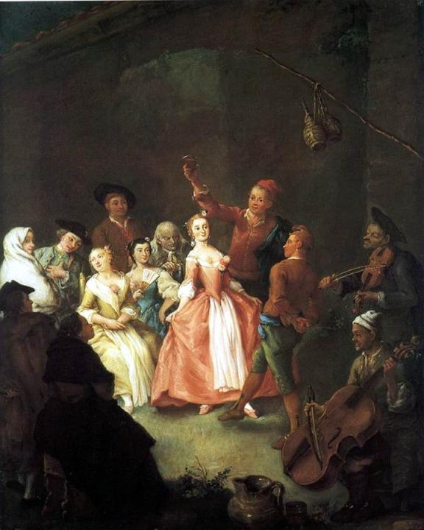
Pietro Longhi
Peasants Dancing La Furlana c. 1750 Oil on canvas
61 x 50 cm Private collection

Slide 20
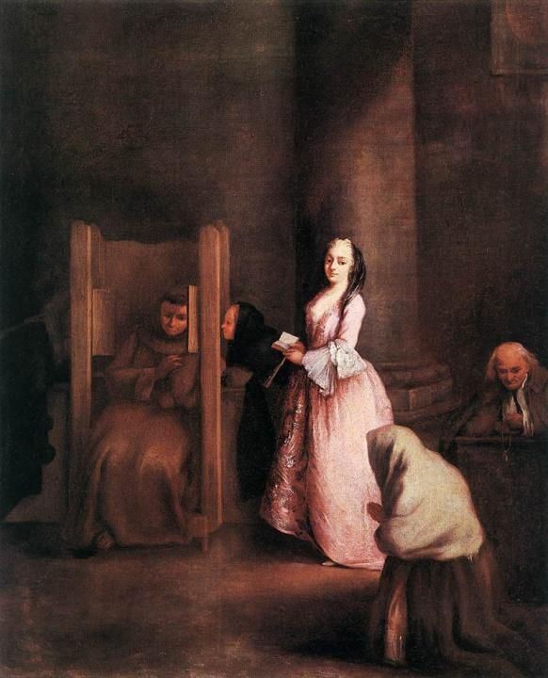
Pietro Longhi
The Confession 1750s Oil on canvas
61 x 50 cm Galleria degli Uffizi Florence

Slide 21
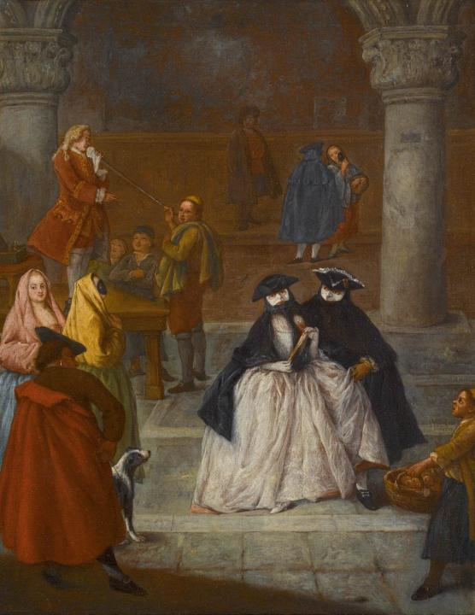
Pietro Longhi
The Fortune Teller 1750s Oil on canvas
62 x 49 cm Private collection

Slide 22
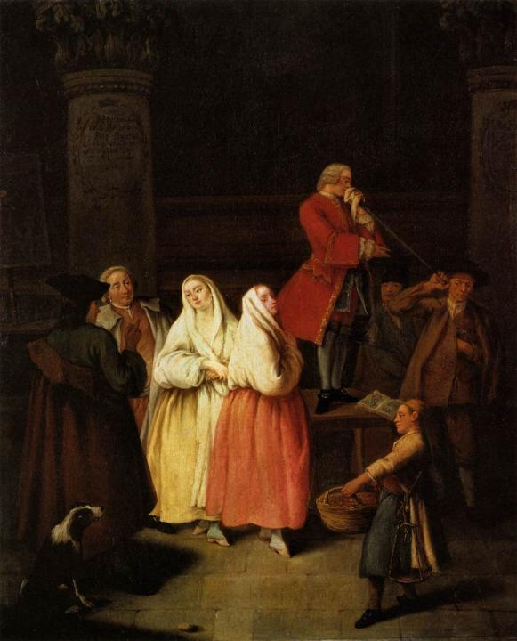
Pietro Longhi
The Soothsayer c. 1750 Oil on canvas
60 x 48 cm Gallerie dell'Accademia Venice

Slide 23
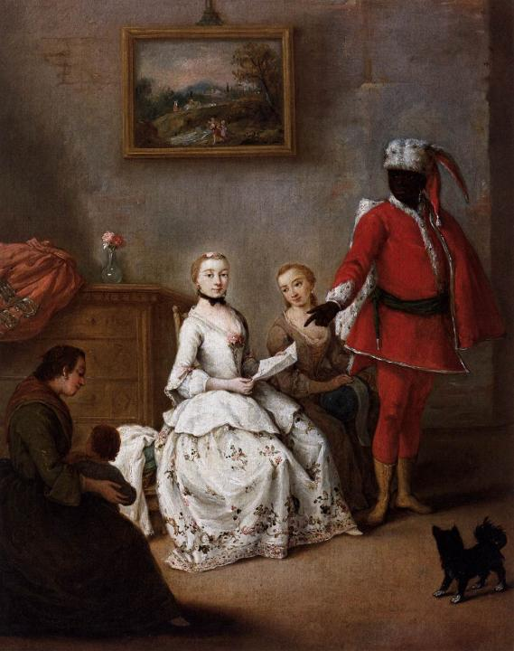
Pietro Longhi
The Letter of the Moor c. 1751 Oil on canvas
62 x 50 cm Museo del Settecento Veneziano
Ca' Rezzonico, Venice

Slide 24
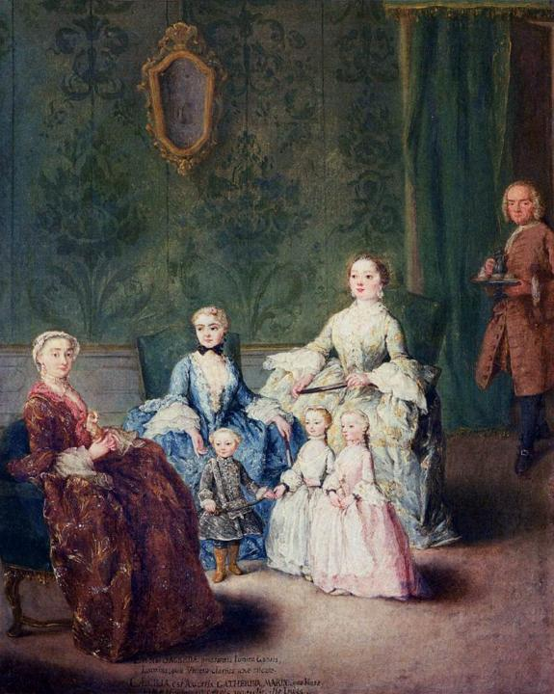
Pietro Longhi
The Sagredo Family c. 1752 Oil on canvas
62 x 51 cm Fondazione Querini Stampalia, Venice

Slide 25
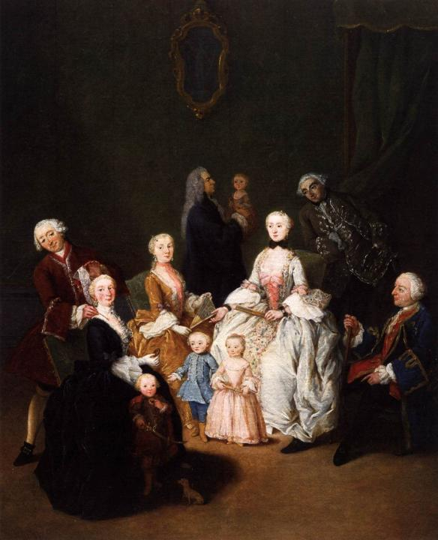
Pietro Longhi
Patrician Family c. 1752 Oil on canvas
62 x 50 cm Museo del Settecento Veneziano
Ca' Rezzonico, Venice

Slide 26
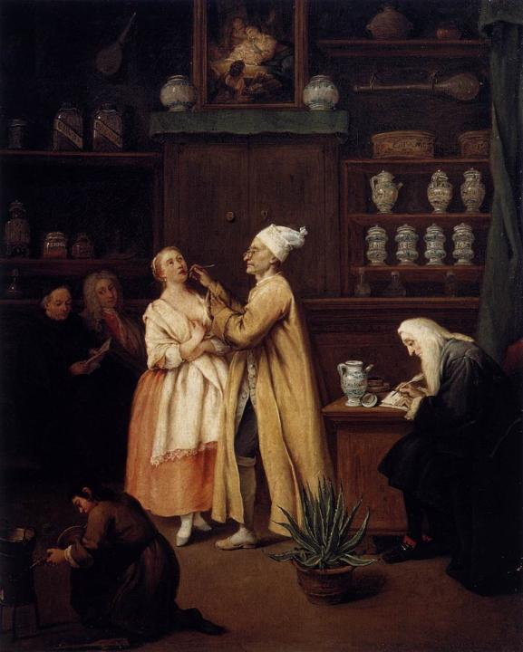
Pietro Longhi
The Apothecary c. 1752 Oil on canvas
59 x 48 cm Gallerie dell'Accademia, Venice

Slide 27
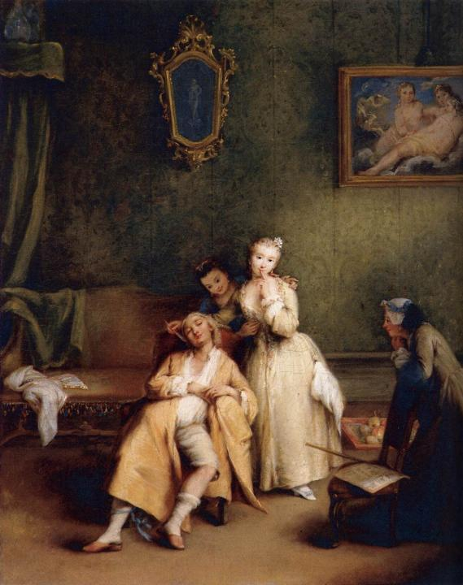
Pietro Longhi
The Tickle c. 1755 Oil on canvas
61 x 48 cm Museo ThyssenBornemisza, Madrid

Slide 28
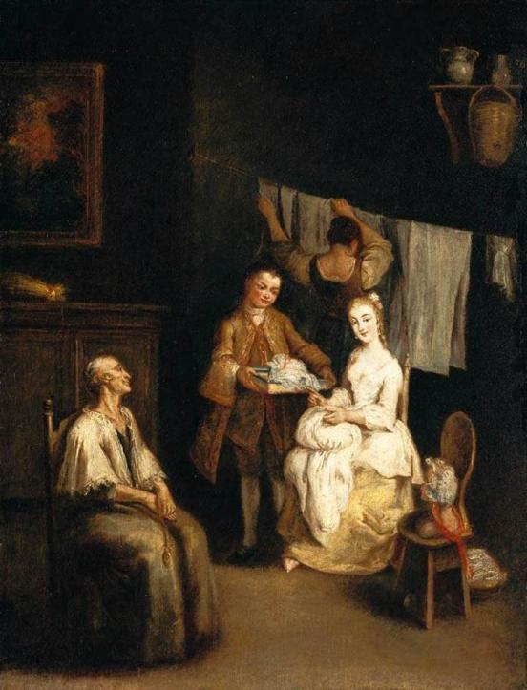
Pietro Longhi
An Interior - Oil on canvas
72 x 56 cm Private collection

Slide 29
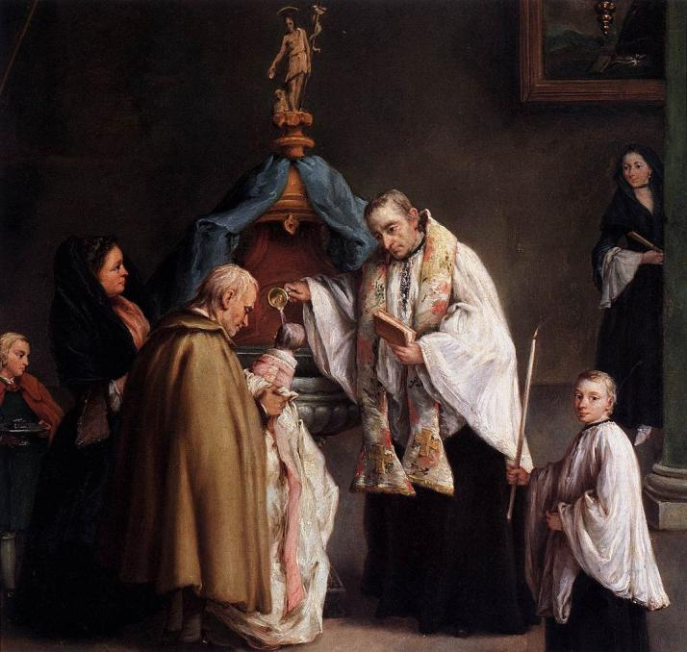
Pietro Longhi
The Baptism
1755
Oil on canvas
60 x 49 cm Fondazione Querini Stampalia Venice

Slide 30
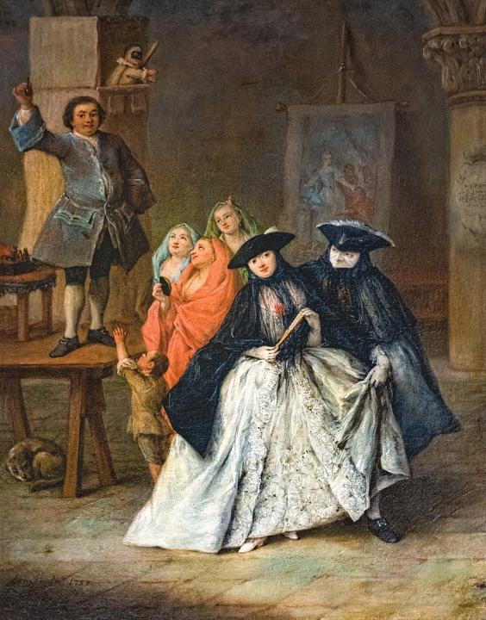
Pietro Longhi
The Mountebank 1757 Oil on canvas Museo del Settecento Veneziano
Ca' Rezzonico, Venice

Slide 31
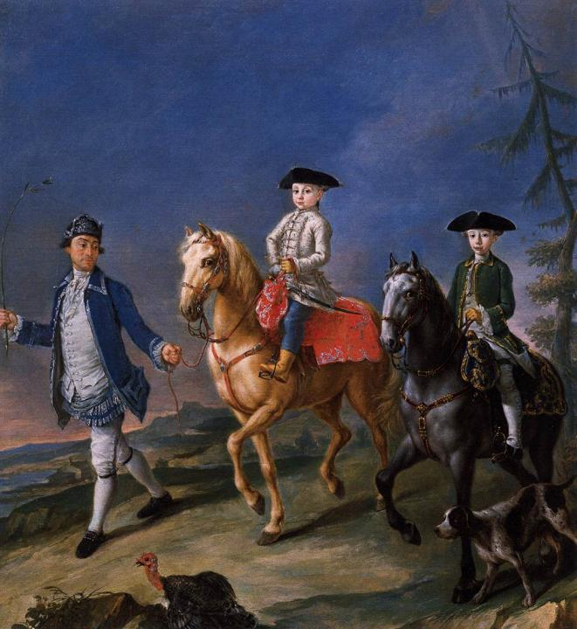
Pietro Longhi Promenade on Horseback 1755-60 Oil on canvas
58 x 62 cm Museo del Settecento Veneziano
Ca' Rezzonico, Venice

Slide 32
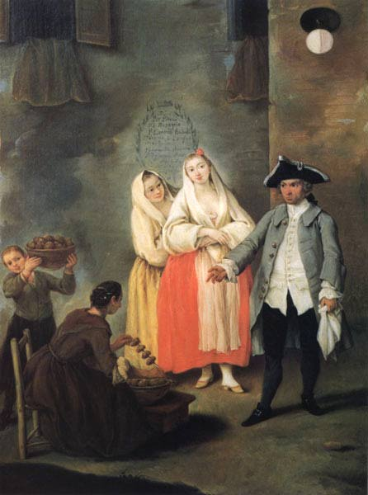
Pietro Longhi
Vendor of Roast Meat c. 1757 Oil on canvas Museo del Settecento Veneziano, Ca' Rezzonico, Venice

Slide 33
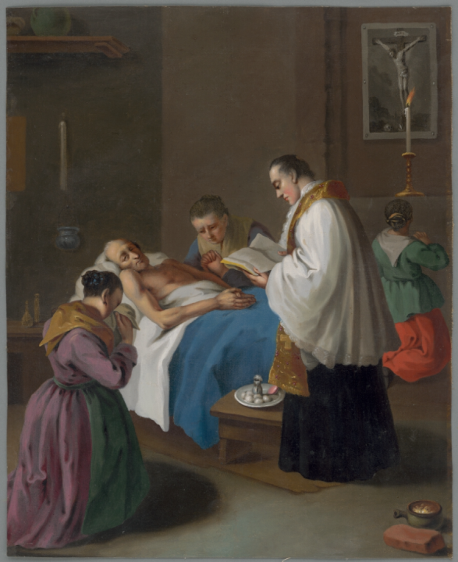
Pietro Longhi
Extremae Unctionis Sacramentum after
1757 oil on canvas
54.7 x 44.1 cm
Galéria mesta Bratislava Bratislava

Slide 34
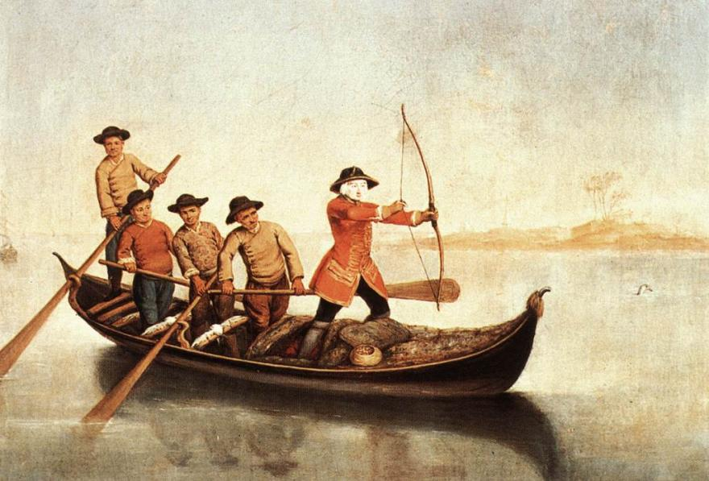
Pietro Longhi: Duck Hunters on the Lagoon, c. 1760 Oil on canvas, Pinacoteca Querini Stampalia, Venice

Slide 35
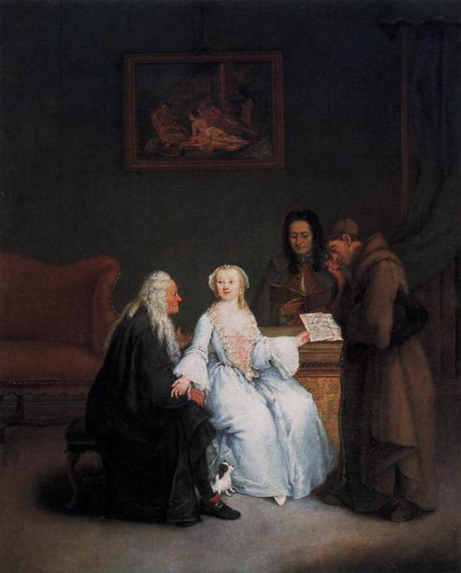
Pietro Longhi
Music Lesson 1760s Oil on canvas
62 x 49 cm Staatliche Museen
Berlin

Slide 36
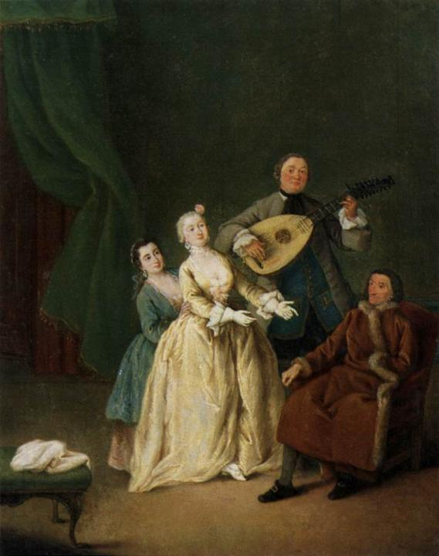
Pietro Longhi
The Family Concert c. 1760 Oil on canvas Museo del Settecento Veneziano
Ca' Rezzonico, Venice

Slide 37
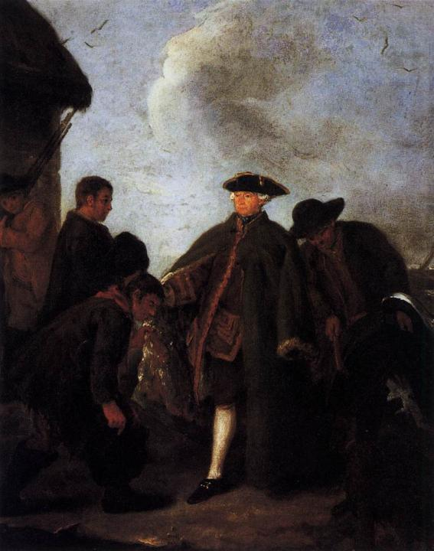
Pietro Longhi
Arriving for the Hunt 1767-70 Oil on canvas Fondazione Querini Stampalia, Venice

Slide 38
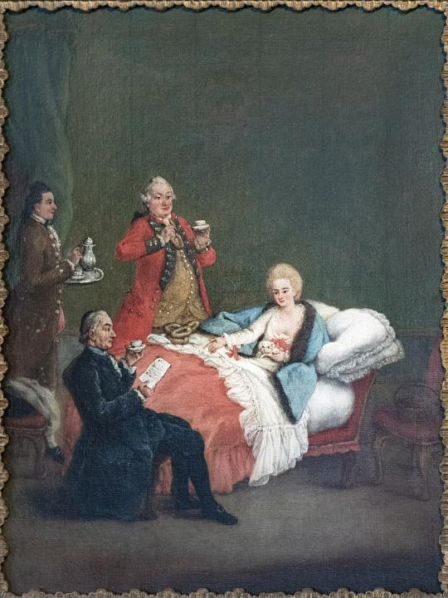
Pietro Longhi
Morning chocolate
1775- 1780
oil on canvas
60 x 47 cm
Ca' Rezzonic Venise, Italy

Slide 39
RINOCÉROSZ-ELEFÁNT

Slide 40
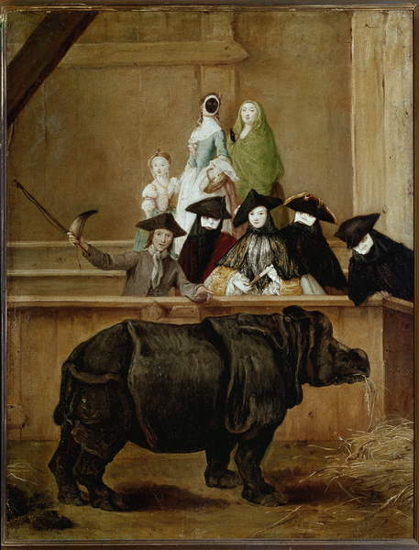
Pietro Longhi
Clara, Exhibition Indian Rhinoceros
1751
Oil on canvas
62 x 50 cm
National Gallery London

Slide 41
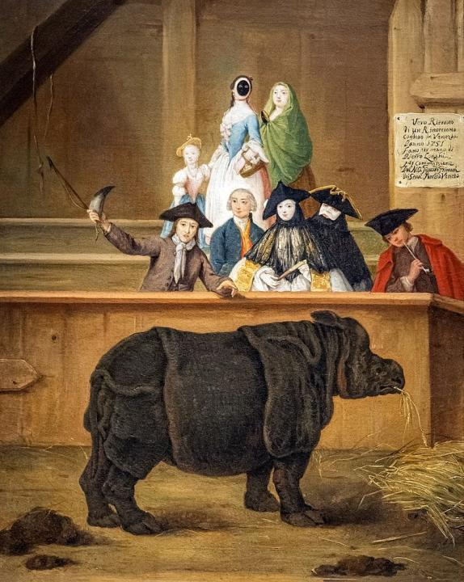
Pietro Longhi
The Rhinoceros 1751 Oil on canvas
62 x 50 cm Museo del Settecento Veneziano
Ca' Rezzonico, Venice

Slide 42
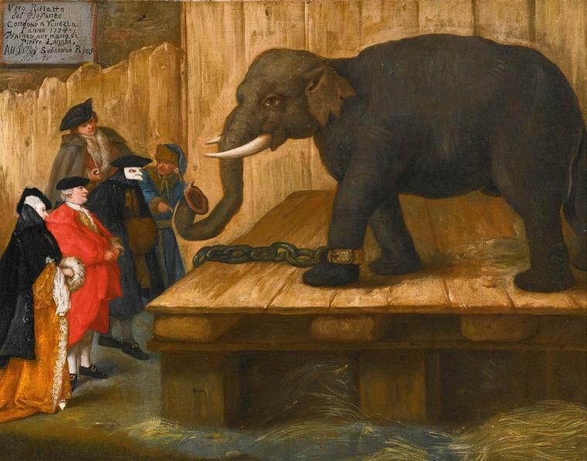
Pietro Longhi: The Elephant, 1774, Oil on canvas, 48 x 61 cm Private collection

Slide 43
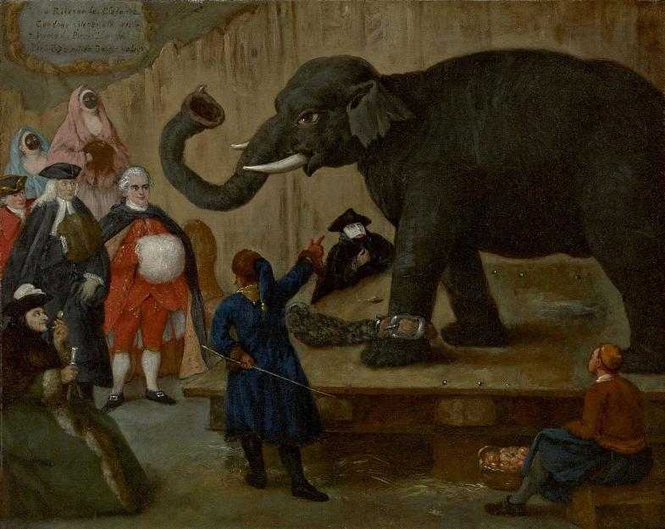
Pietro Longhi: The Display of the Elephant, oil on canvas
48,3 × 60,3 cm Museum of Fine Arts, Houston, Texas

Slide 44
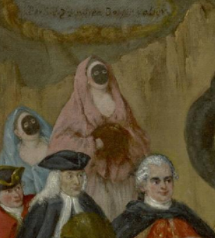
Pietro Longhi
The Display of the Elephant
(detail)
oil on canvas
48,3 × 60,3 cm Museum of Fine Arts Houston, Texas

Slide 45
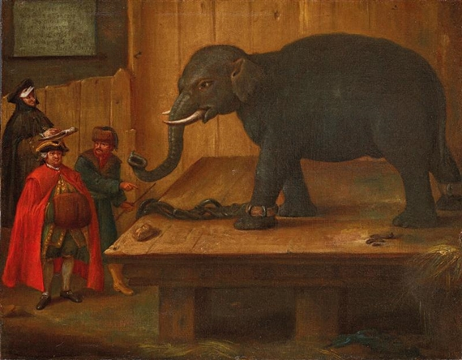
Pietro Longhi: The Elephant, 1774, oil on canvas, 48 x 61, 5 cm

Slide 46
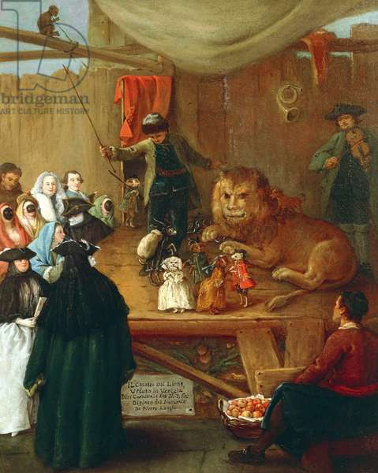
Pietro Longhi
The Lion's Cage
1762
oil on canvas
51 x 61 cm
Querini Stampalia Foundation, Venice

Slide 47
PORTRÉK

Slide 48
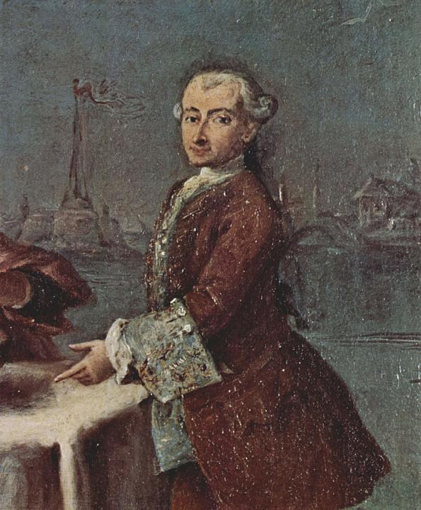
Pietro Longhi
Self portrait
circa 1759
Oil on canvas

Slide 49
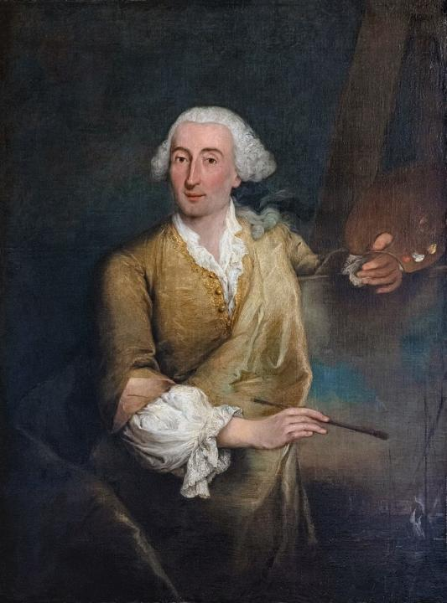
Pietro Longhi
Portrait of Francesco Guardi c. 1760 Oil on canvas
132 x 100 cm Museo del Settecento Veneziano, Ca' Rezzonico Venice

Slide 50
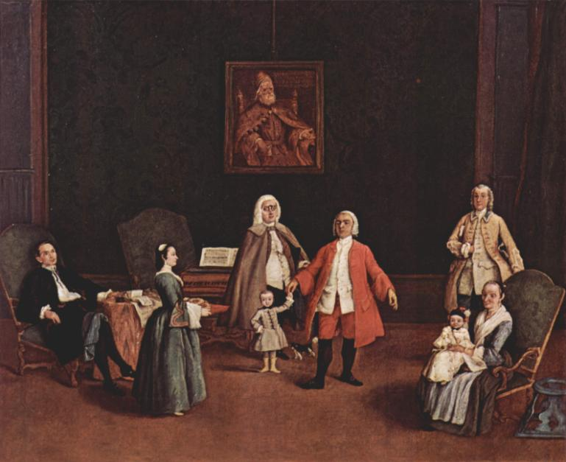
Pietro Longhi: Venetian family portrait, 1760-1765, oil on canvas
80 × 89 cm, Collezione Eredi Salom, Segromigno in Monte

Slide 51
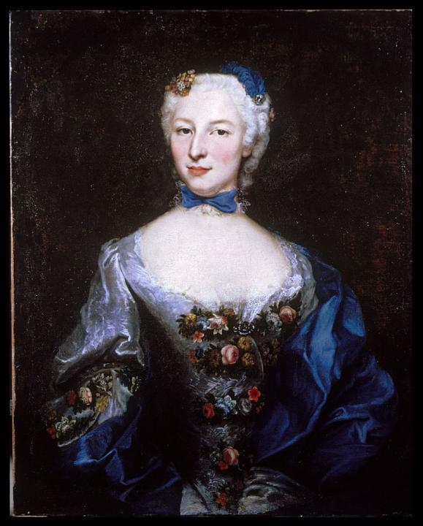
Pietro Longhi
Portrait of a Lady
between circa 1760
and circa 1769
oil on canvas
80.6 x 65.2 cm
Walters Art Museum Baltimore, U.S.A.

Slide 52
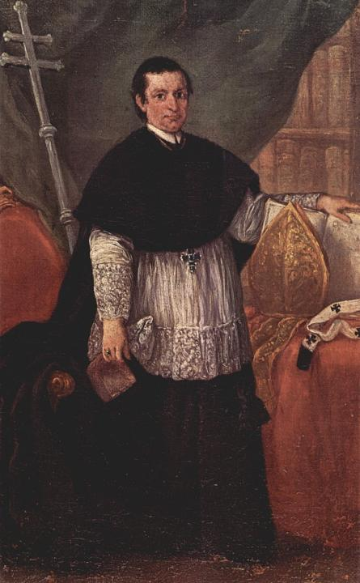
Pietro Longhi
Ritratto del vescovo Benedetto Ganassoni
1774
Oil on canvas

Slide 53
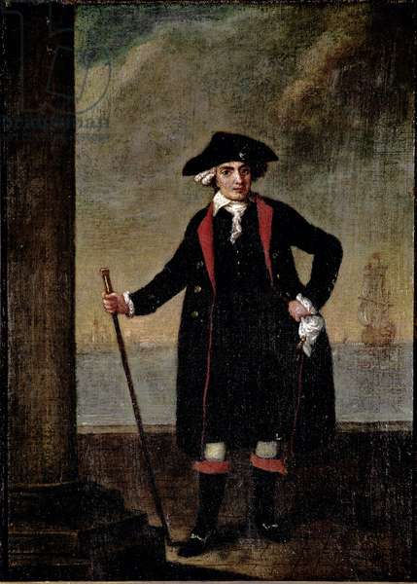
Pietro Longhi
Portrait of the Italian Ship Captain Piero Rinaldi
ca. 1781
51 x 38 cm
Ca 'Rezzonico, Venice

Slide 54
Pietro Longhi
Portrait of a Senator of the Republic
oil on canvas
Museo Correr, Venice

Slide 55
GRAFIKÁK

Slide 56
Pietro Longhi
A Dignitary Holding a Document
c.1722–42
Red chalk
25 x 17 cm
Metropolitan Museum of Art, New York

Slide 57
Pietro Longhi
Lute Player 1752 Chalk and charcoal on paper Museo Correr, Venice

Slide 58
Peter Longhi
Wine-pourer with a Young Man
black and white chalk on brown laid paper

Slide 59
Pietro Longh: A violinist (Violin player), Drawing, Musee Corre Venice

Slide 60
Pietro Longhi: Masked Gentleman (Gentiluomo con bautta

Slide 61
Pietro Longhi: Lady at the spinning wheel, Charcoal and white chalk on brown paper, 28 x 38,5 cm, The Cabinet of Drawings and Prints of the Civic Museum, Venice

Slide 62
Pietro Longh: Painter at the easel, two gentlemen in bauta. Charcoal, white chalk, paper

