Slide 1
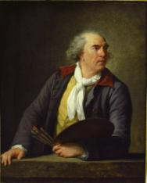
HUBERT ROBERT
Hubert Robert (1733. május 22. – 1808. április 15.) a romantika festészetét képviselte, különösen tájképeivel és capricci -jaival , vagy félig fiktív festői olaszországi és franciaországi romábrázolásával

Slide 2
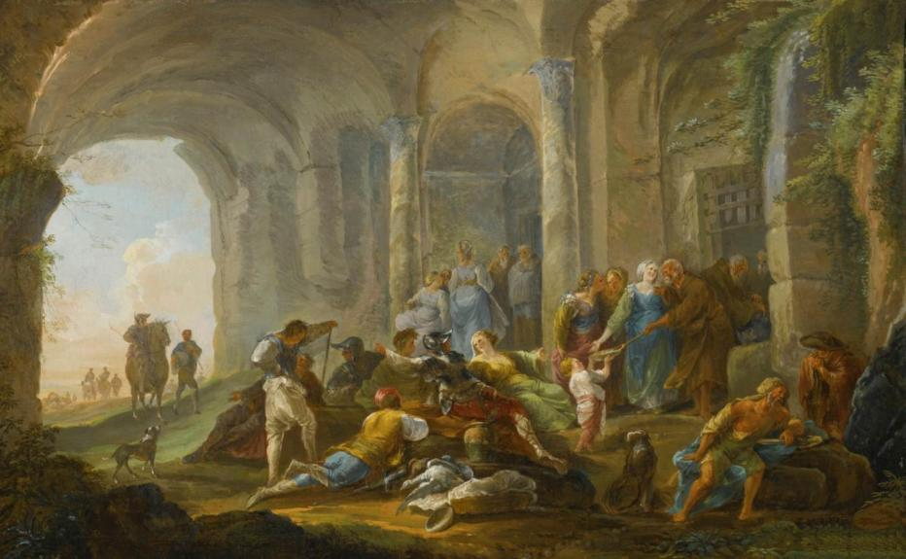
Hubert Robert: Roman Figures under an Arcade, 1755-60 Oil on canvas, 45 x 72 cm, Private collection

Slide 3
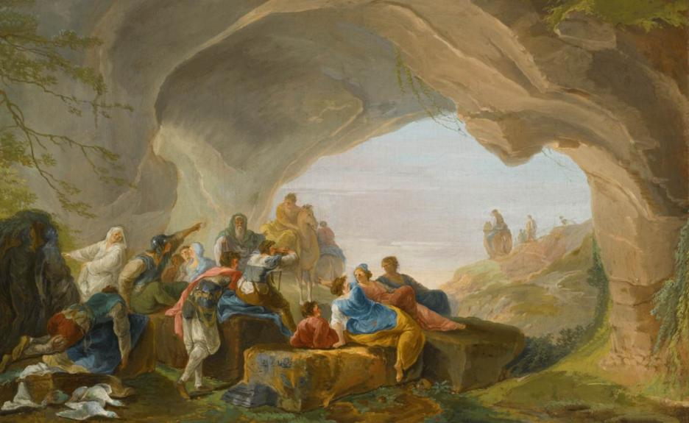
Hubert Robert: Roman Figures in a Cave, 1755-60, Oil on canvas
45 x 72 cm, Private collection

Slide 4
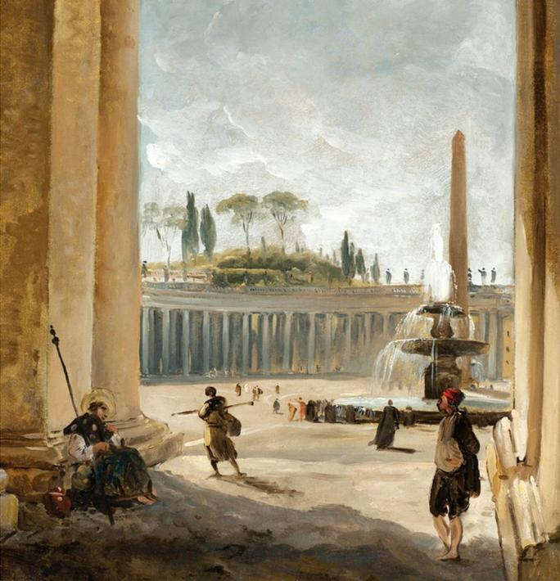
Hubert Robert
St. Peter's Square Rome c. 1760 Oil on paper laid on canvas
33 x 33 cm Private collection

Slide 5
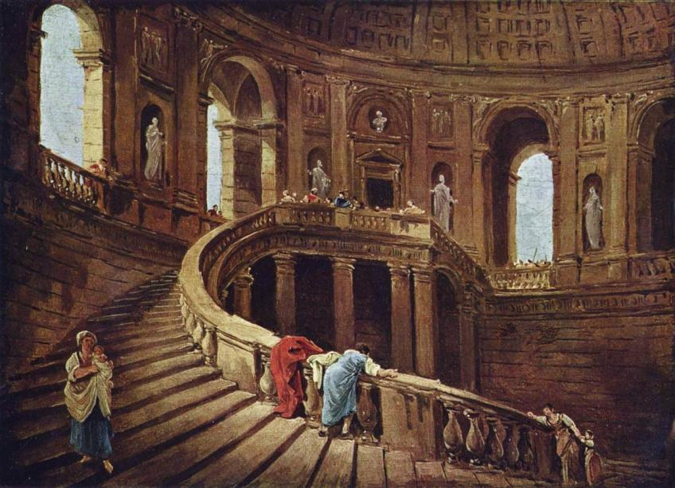
Hubert Robert: Staircase (Scala Regia) in the Palace of Caprarola 1760s, Oil on canvas, 25 x 34 cm,Musée du Louvre, Paris

Slide 6
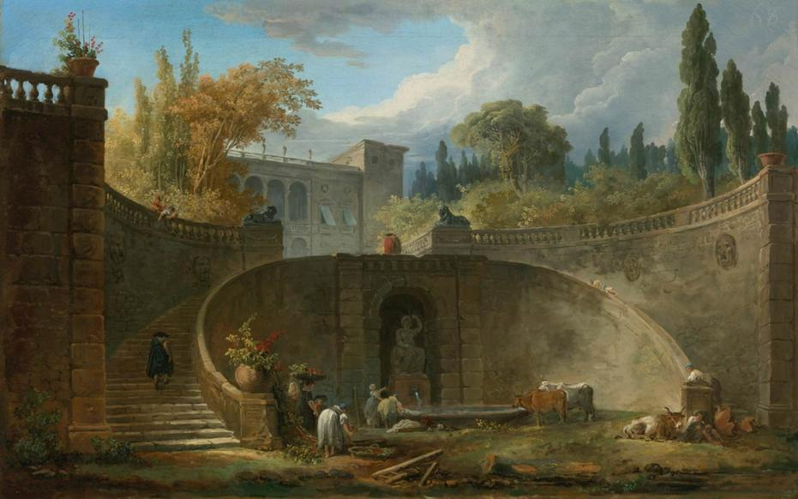
Hubert Robert: Villa Farnese with Gardens at Caprarola, c. 1764 Oil on canvas, 46 x 72 cm, Private collection

Slide 7
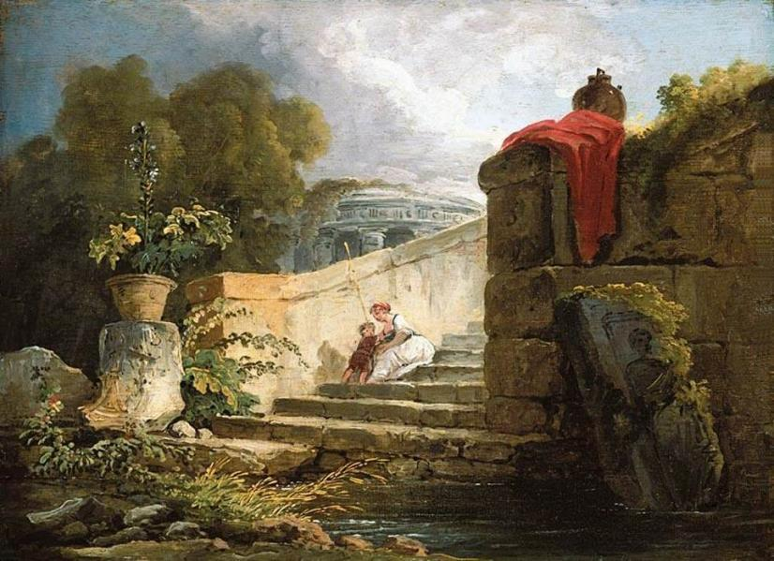
Hubert Robert: A Scene in the Grounds of the Villa Farnese, Rome c. 1765, Oil on panel, 25 x 35 cm, Private collection

Slide 8
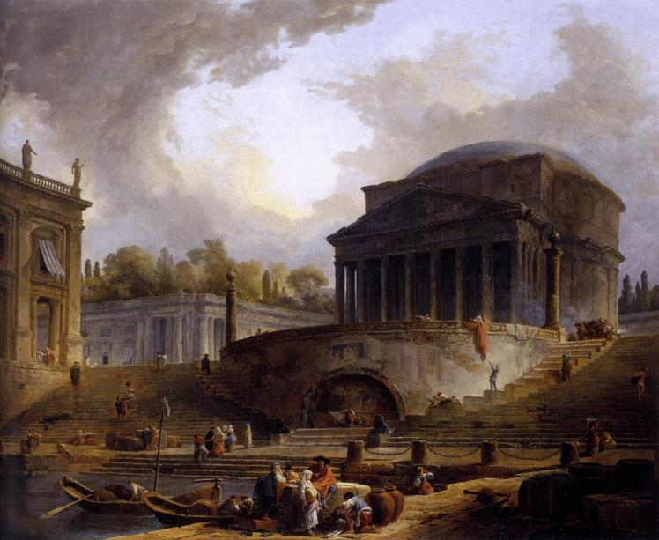
Hubert Robert: View of Ripetta,1766, Oil on canvas, 119 x 145 cm École Nationale Supérieure des Beaux-Arts, Paris

Slide 9
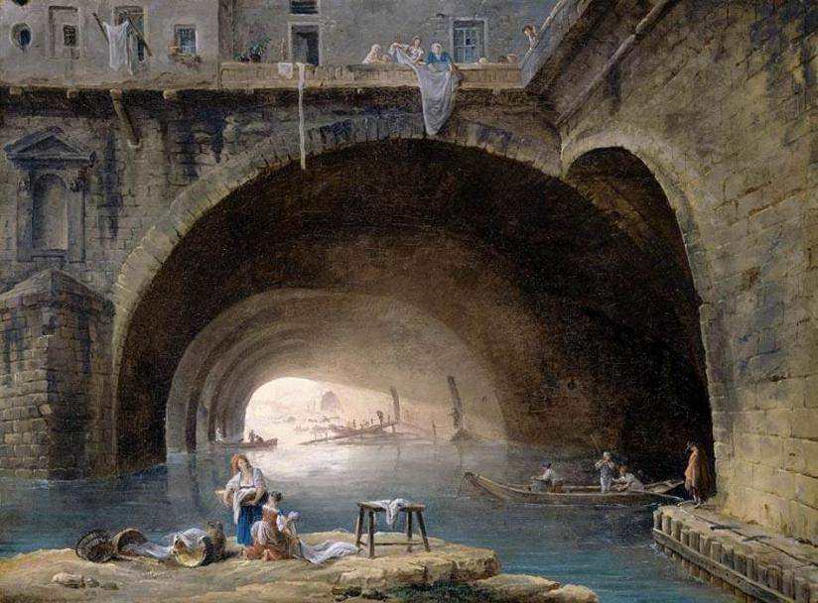
Hubert Robert: La Bièvre, 1768, Oil on canvas, 55 x 74 cm Private collection

Slide 10
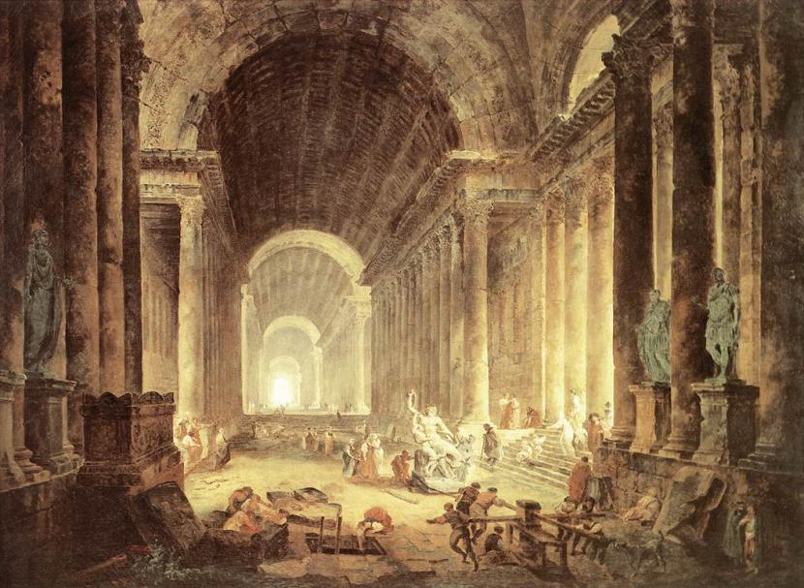
Hubert Robert: The Finding of the Laocoon, 1773 Oil on canvas, 119 x 163 cm, Virginia Museum of Fine Arts, Richmond

Slide 11
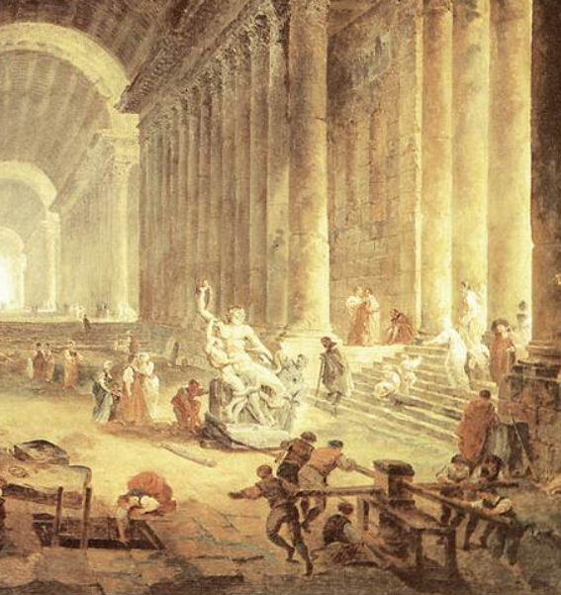
Hubert Robert
The Finding of the Laocoon
(detail)
1773 Oil on canvas
Virginia Museum of Fine Arts, Richmond

Slide 12
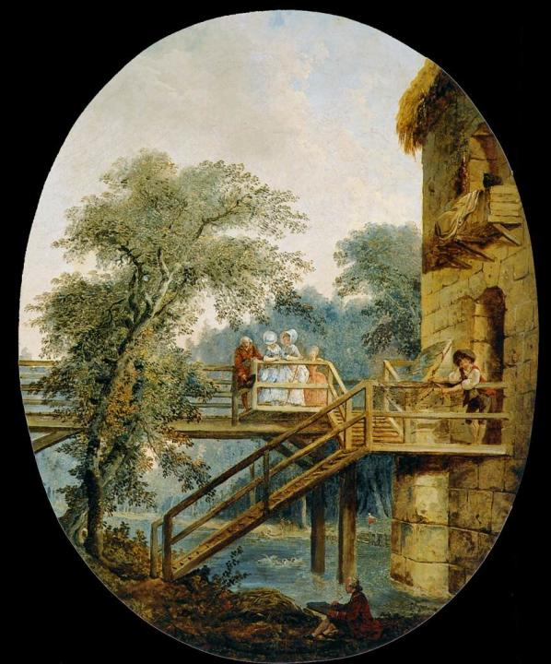
Hubert Robert
The Footbridge c. 1775 Oil on canvas
59 x 47 cm Museo Thyssen Bornemisza, Madrid

Slide 13
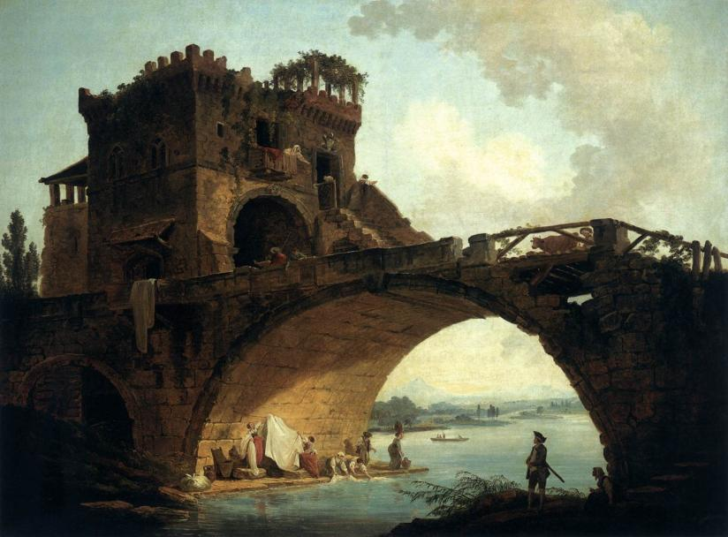
Hubert Robert: The Ponte Solario, c. 1775, Oil on canvas, 91 x 121 cm National Gallery of Art, Washington

Slide 14
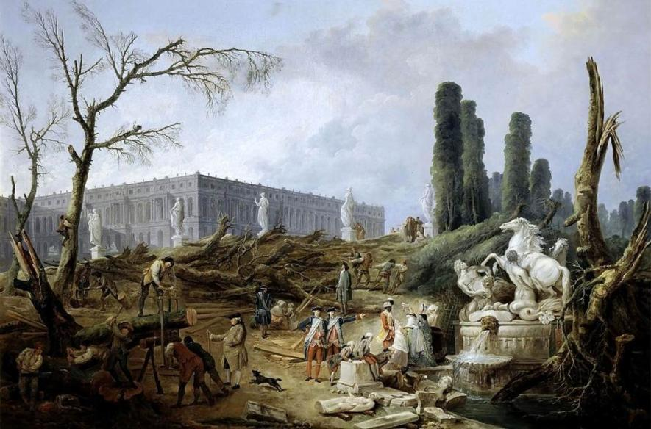
Hubert Robert: The Grove and Bath of Apollo, 1776, Oil on canvas
124 x 191 cm, Musée National du Château, Versailles

Slide 15
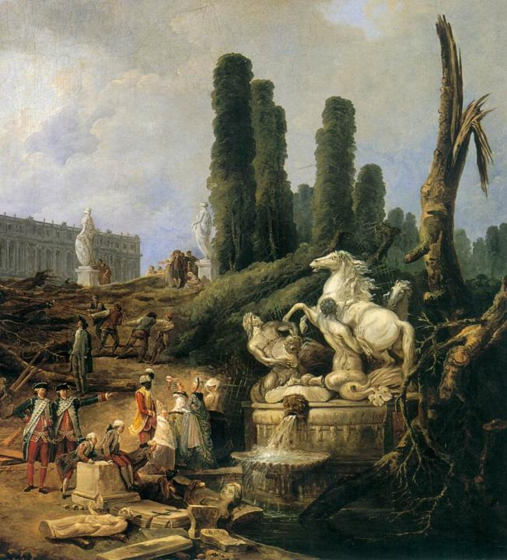
Hubert Robert
The Grove and Bath of Apollo
(detail) 1776 Oil on canvas Musée National du Château, Versailles

Slide 16
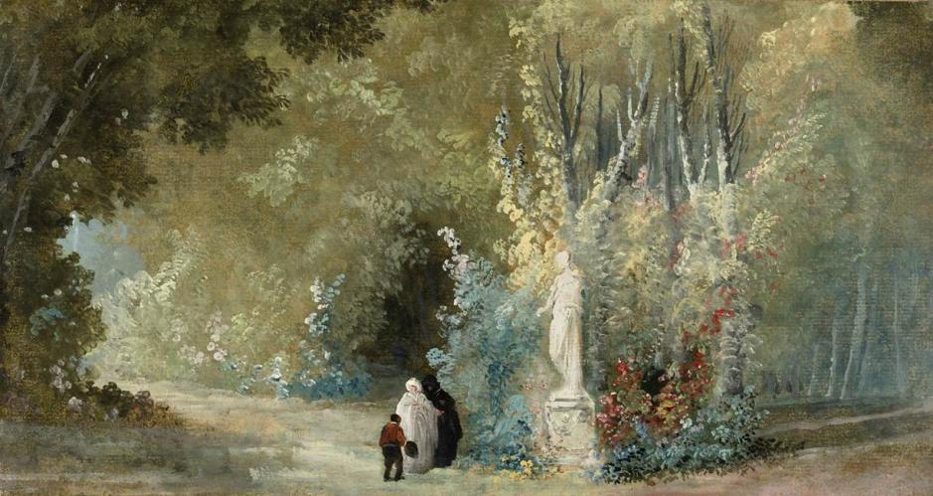
Hubert Robert: Landscape with Three Figures before a Statue, c. 1778 Oil on paper, laid on canvas, 21 x 38 cm, Private collection

Slide 17
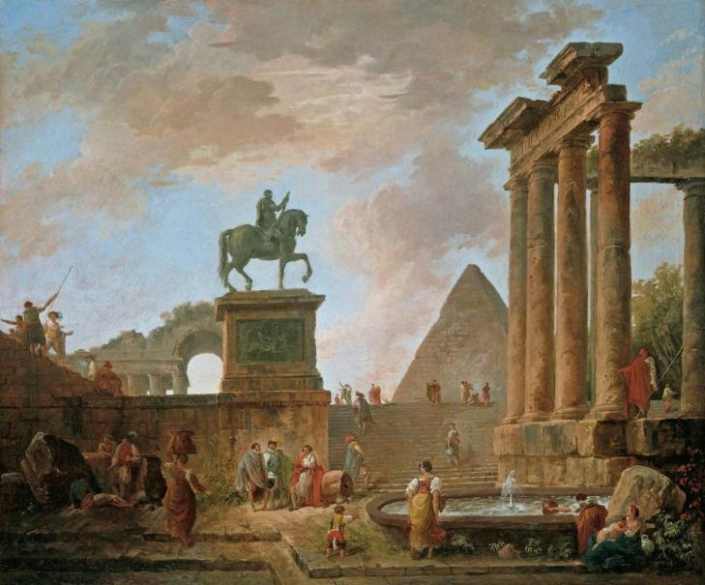
Hubert Robert: Architectural Capriccio, c. 1780, Oil on canvas
67 x 81 cm, Private collection

Slide 18
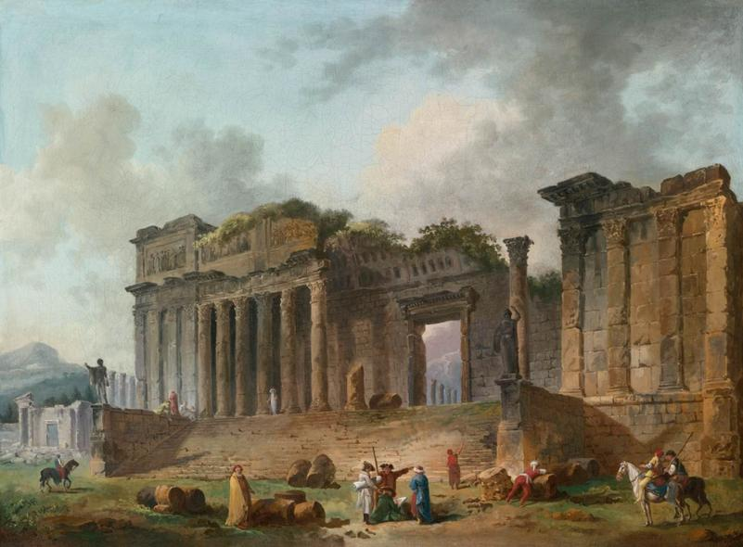
Hubert Robert: An Architectural Capriccio, 1782, Oil on canvas
50 x 67 cm, Private collection

Slide 19
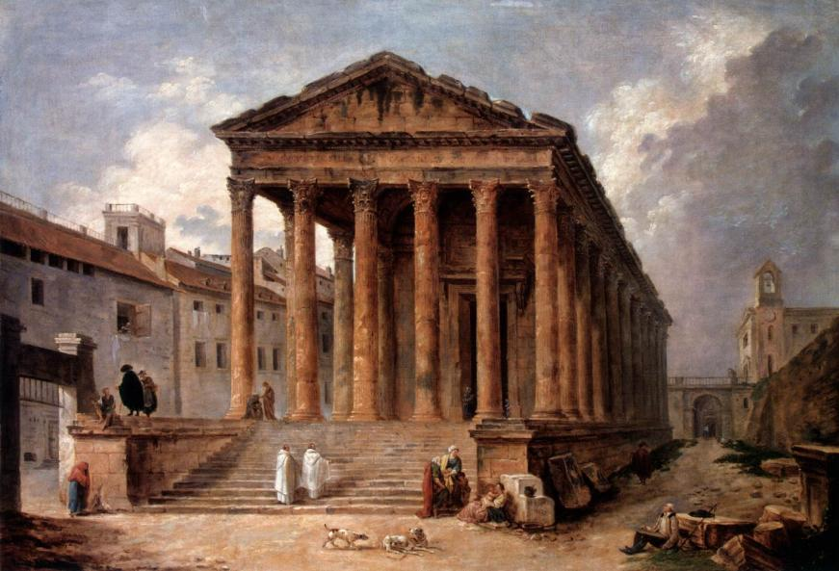
Hubert Robert: The Maison Carée in Nimes, 1783, Oil on canvas
102 x 143 cm, The Hermitage, St. Petersburg

Slide 20
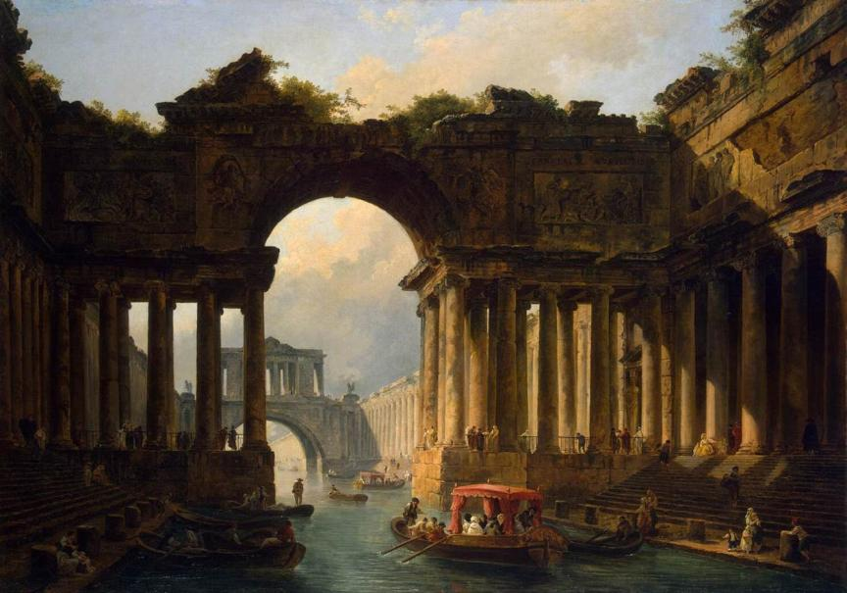
Hubert Robert: Architectural Landscape with a Canal,1783 Oil on canvas, 129 x 183 cm, The Hermitage, St. Petersburg

Slide 21
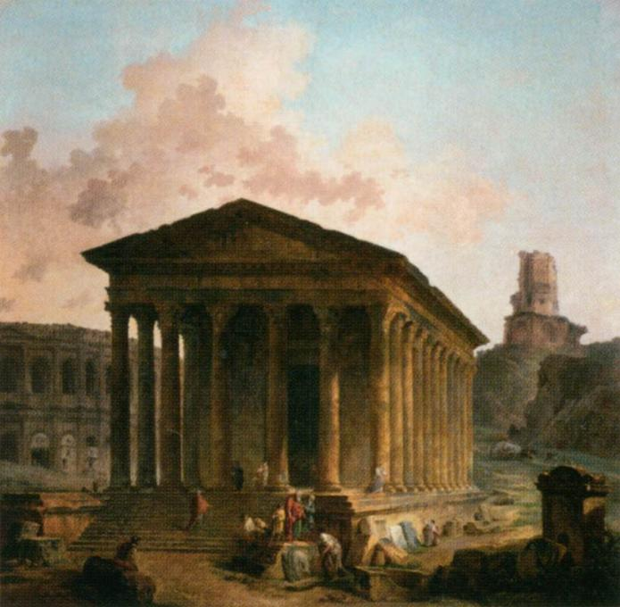
Hubert Robert
The Maison Carrée, the Arenas and the Magne Tower in Nimes 1787 Oil on canvas
243 x 244 cm Musée du Louvre Paris

Slide 22
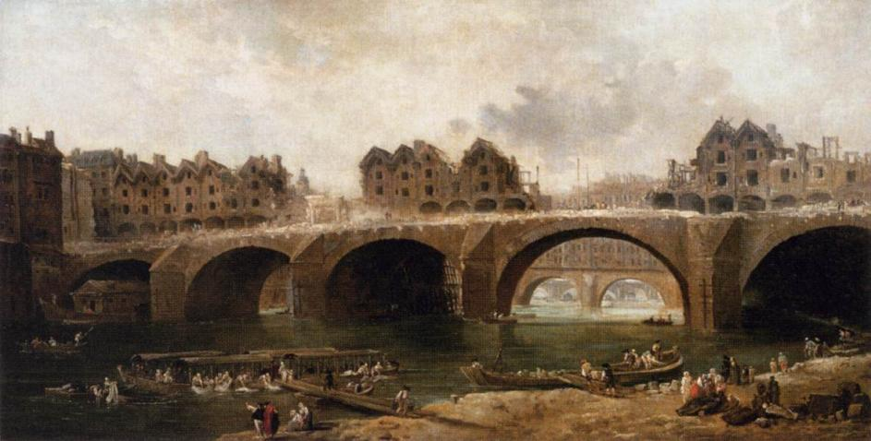
Hubert Robert: Demolition of the Houses on the Pont Notre-Dame in 1786, Oil on canvas, 73 x 140 cm, Musée du Louvre, Paris

Slide 23
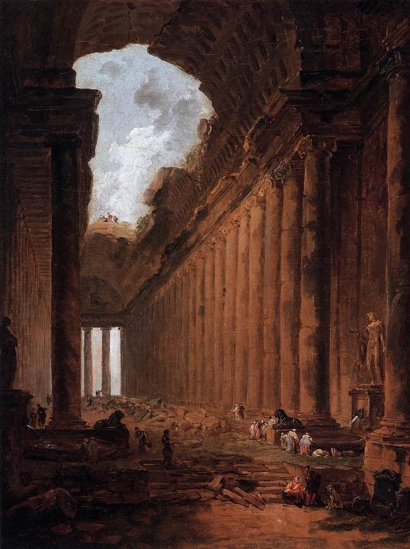
Hubert Robert
Ruin Capriccio c. 1786 Oil on canvas
41 x 31 cm Akademie der bildenden Künste, Vienna

Slide 24
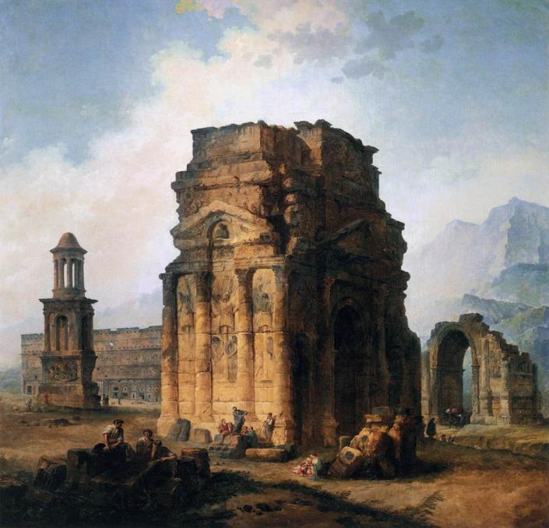
Hubert Robert The Arc de Triomphe and the Theatre of Orange 1787 Oil on canvas
242 x 242 cm Musée du Louvre Paris

Slide 25
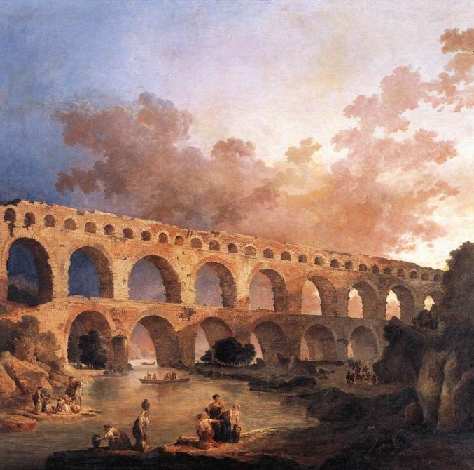
Hubert Robert
The Pont du Gard 1787 Oil on canvas
242 x 242 cm Musée du Louvre Paris

Slide 26
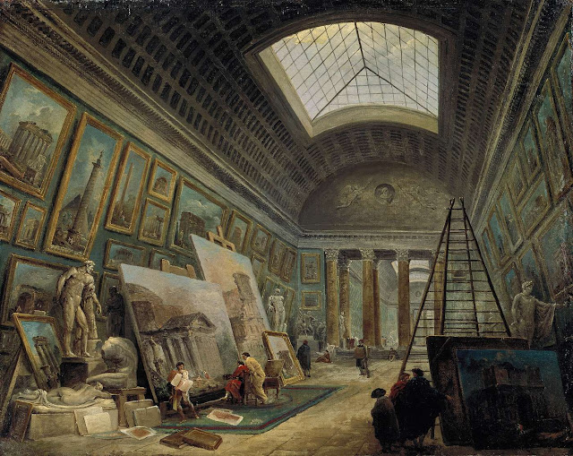
Hubert Robert: Imaginary View of the Grande Galerie in the Louvre 1789, Oil on canvas, 65 x 81 cm, Musée du Louvre, Paris

Slide 27
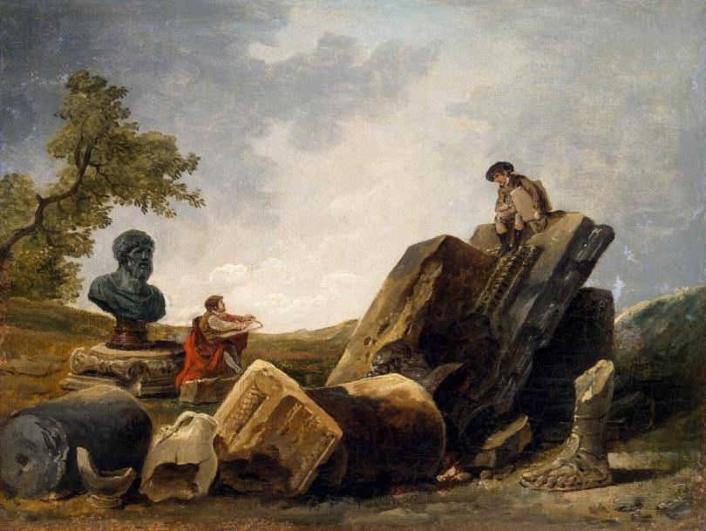
Hubert Robert: Painters, 1790s, Oil on canvas, 24 x 32 cm
The Hermitage, St. Petersburg

Slide 28
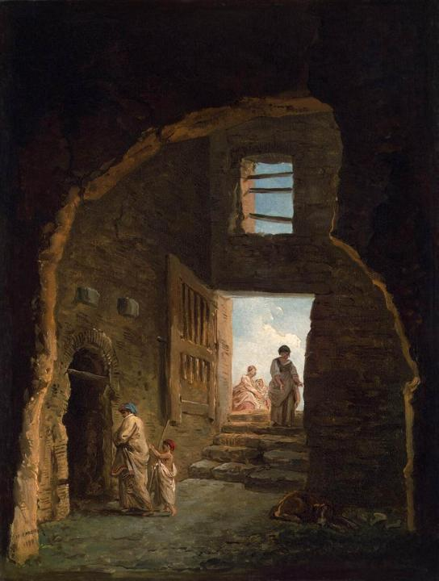
Hubert Robert
Inhabited Ruins 1790 Oil on canvas
40 x 30 cm The Hermitage
St. Petersburg

Slide 29
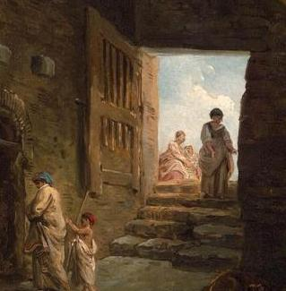
Hubert Robert
Inhabited Ruins
(detail) 1790 Oil on canvas The Hermitage
St. Petersburg

Slide 30
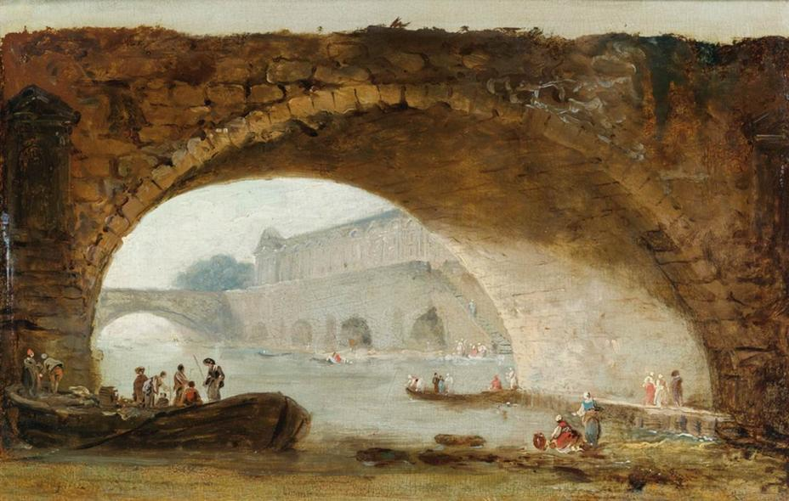
Hubert Robert: Imaginary View of the Louvre through the Arch of a Bridge, c. 1793, Oil on panel, 17 x 26 cm, Private collection

Slide 31
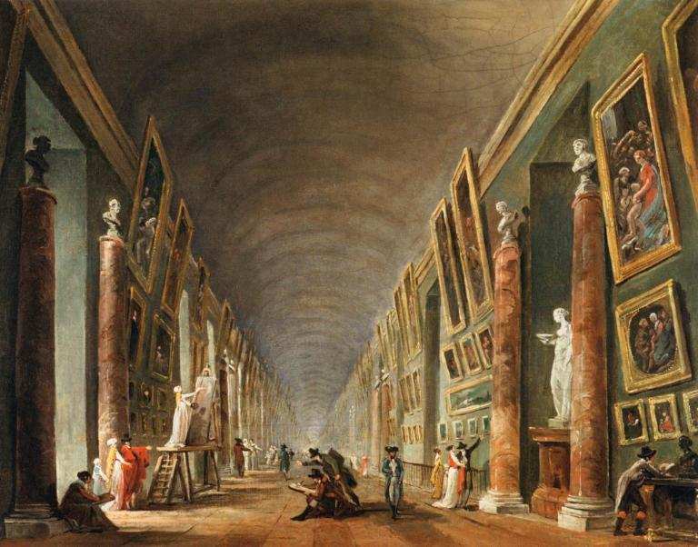
Hubert Robert: The Grande Galerie, c. 1795, Oil on canvas, 37 x 41 cm Musée du Louvre, Paris

Slide 32
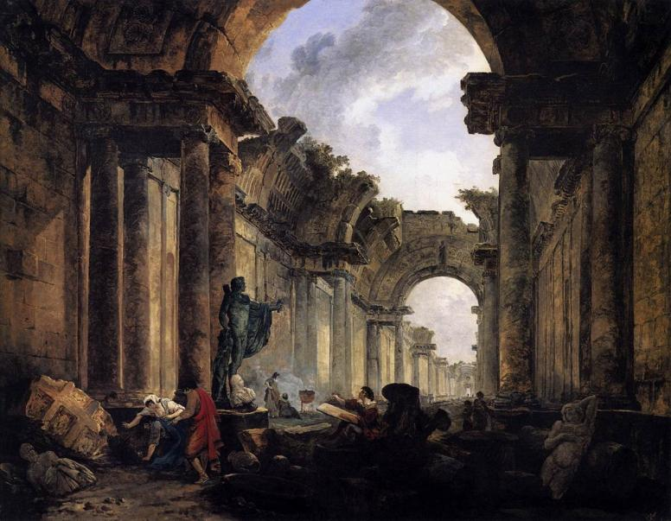
Hubert Robert: Imaginary View of the Grande Galerie in the Louvre in Ruins, 1796, Oil on canvas, 114,5 x 146 cm, Musée du Louvre, Paris

Slide 33
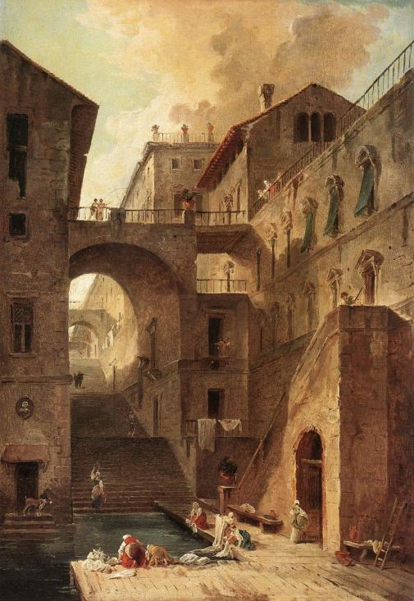
Hubert Robert
Washerwomen 1796 Oil on canvas
60,3 x 41,6 cm Museum of Fine Arts
Boston

Slide 34
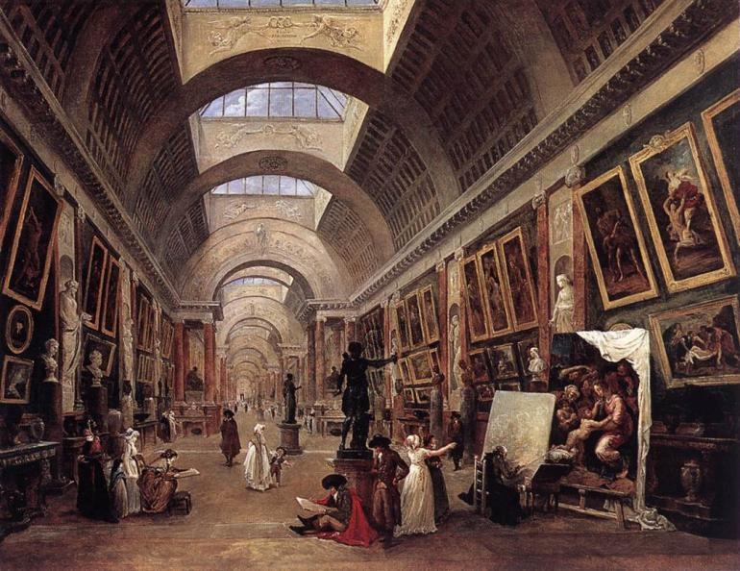
Hubert Robert: Design for the Grande Galerie in the Louvre, 1796 Oil on canvas, 112 x 143 cm, Musée du Louvre, Paris

Slide 35
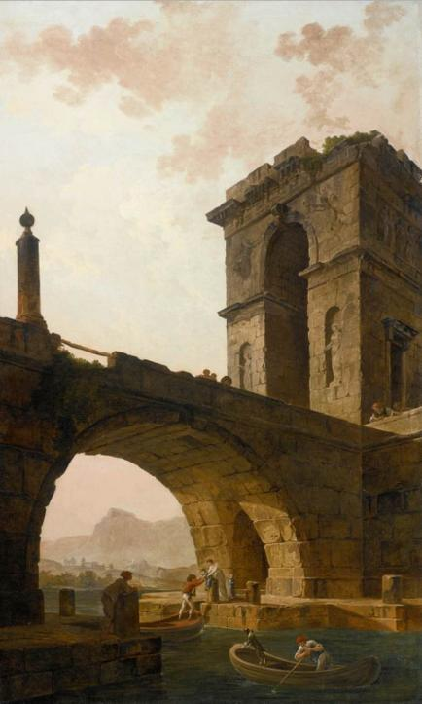
Hubert Robert
Figures under a Bridge c. 1798 Oil on canvas
178 x 109 cm Private collection

Slide 36
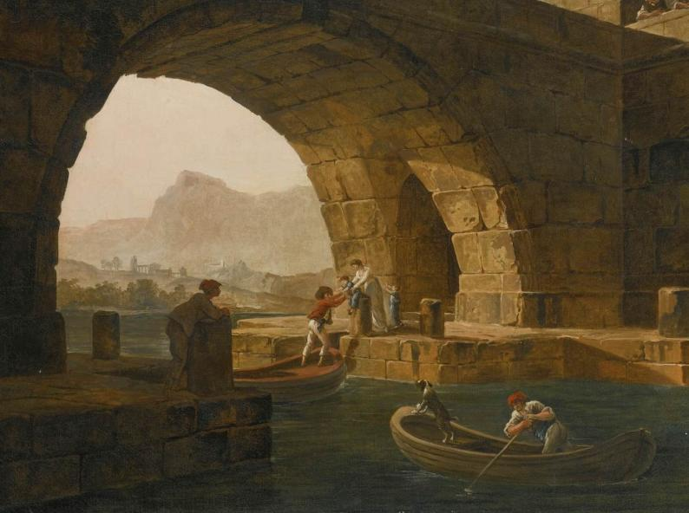
Hubert Robert: Figures under a Bridge, (detail), c. 1798 Oil on canvas, Private collection

Slide 37
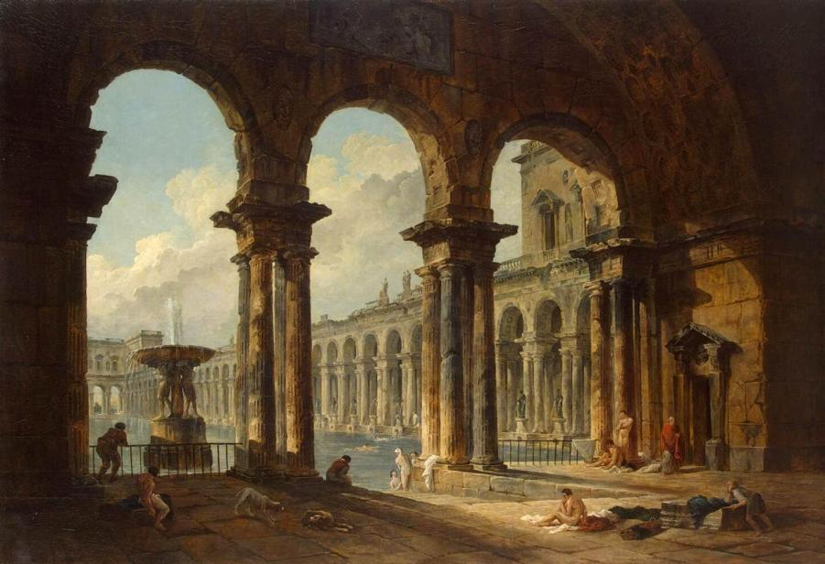
Hubert Robert: Ancient Ruins Used as Public Baths, 1798 Oil on canvas, 133 x 194 cm, The Hermitage, St. Petersburg

Slide 38
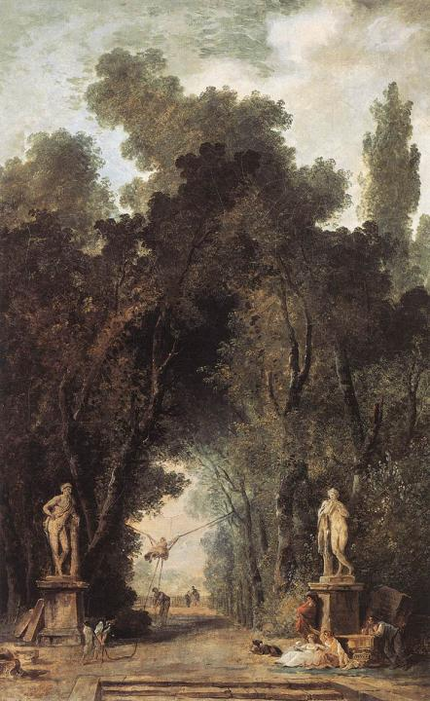
Hubert Robert
Avenue in a Park 1799 Oil on canvas
59 x 39 cm Musées Royaux des
Beaux-Arts, Brussels

Slide 39
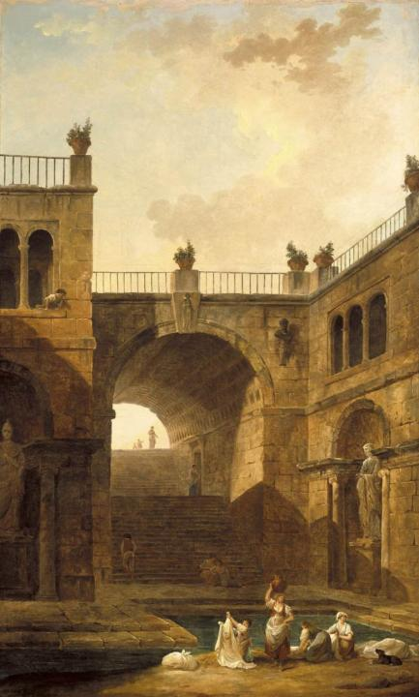
Hubert Robert
Architectural Scene with Women Washing Clothes at a Pool 1799 Oil on canvas
178 x 109 cm Museum of Art
Indianapolis

Slide 40
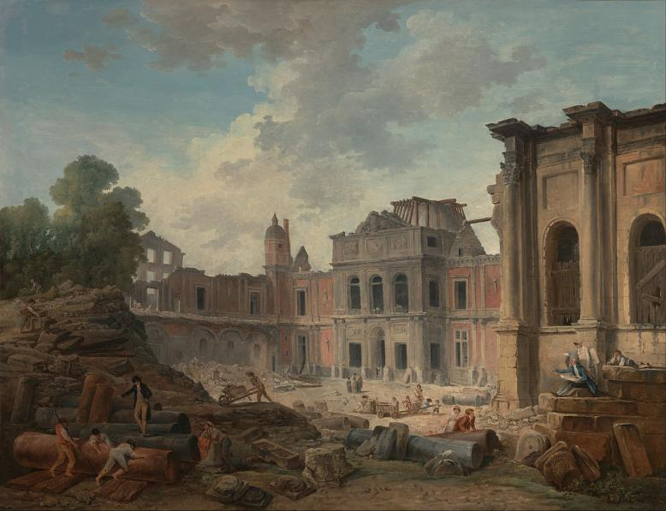
Hubert Robert: Demolition of the Château of Meudon, 1806
oil on canvas, 113.3 × 146 cm, Getty Center, Museum Los Angeles

Slide 41
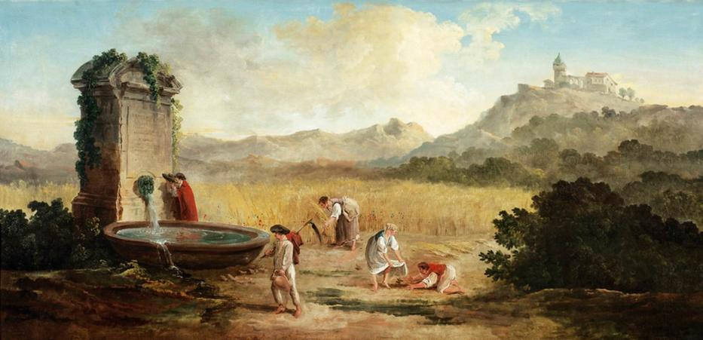
Hubert Robert: Summer: Harvest in the Roman Countryside, 1807 Oil on canvas, 77 x 161 cm, Private collection

Slide 42
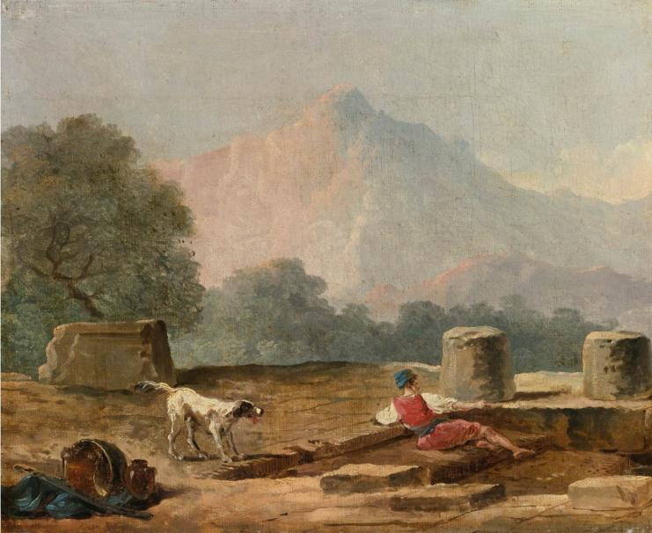
Hubert Robert: A Boy and a Dog among Ruins - Oil on canvas, 38 x 46 cm, Private collection

Slide 43
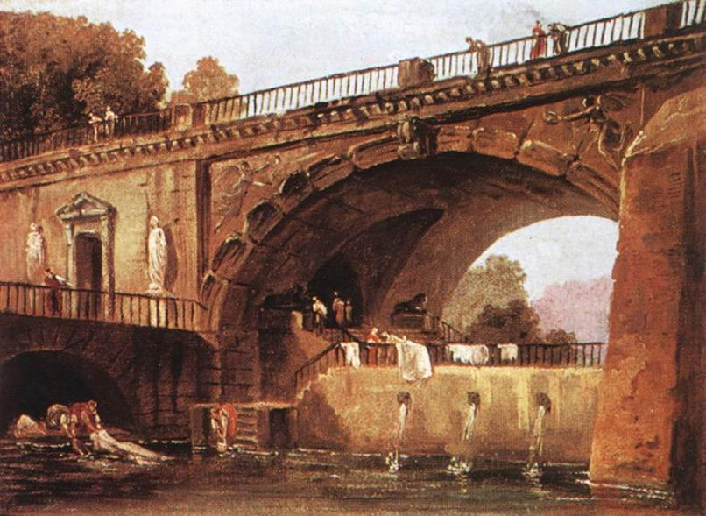
Hubert Robert: Washerwomen below a Bridge - Oil on canvas
24 x 33 cm, Alte Pinakothek, Munich

Slide 44
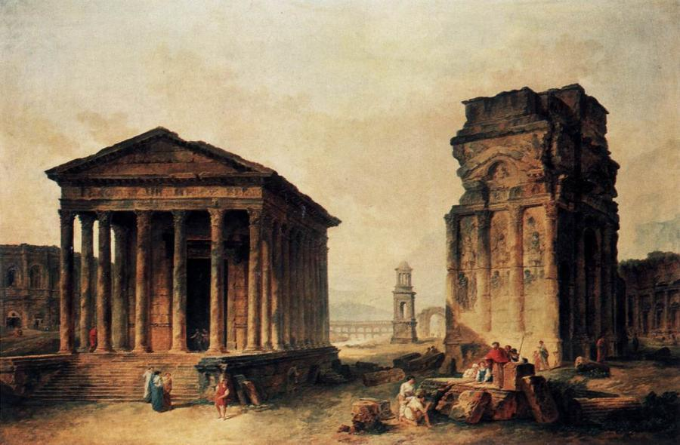
Hubert Robert: Ruins at Nimes - Oil on canvas, 117 x 174 cm Staatliche Museen, Berlin

Slide 45
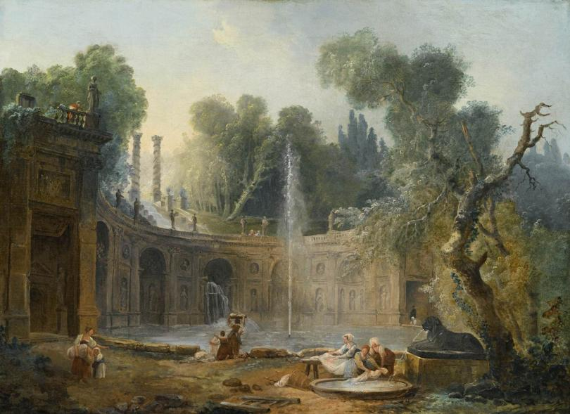
Hubert Robert: The Teatro delle Acque in the Garden of the Villa Aldobrandini, - Oil on canvas, 56 x 76 cm, Private collection

Slide 46
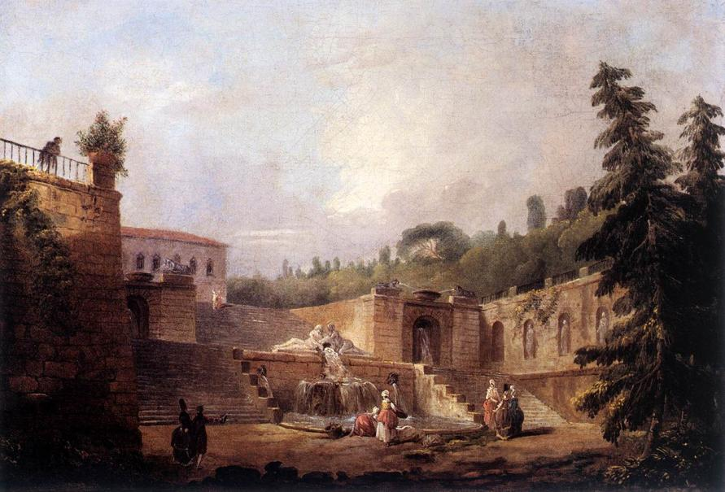
Hubert Robert: Fountain on a Palace Terrace - Oil on canvas
28 x 40 cm, Residenzgalerie, Salzburg

Slide 47
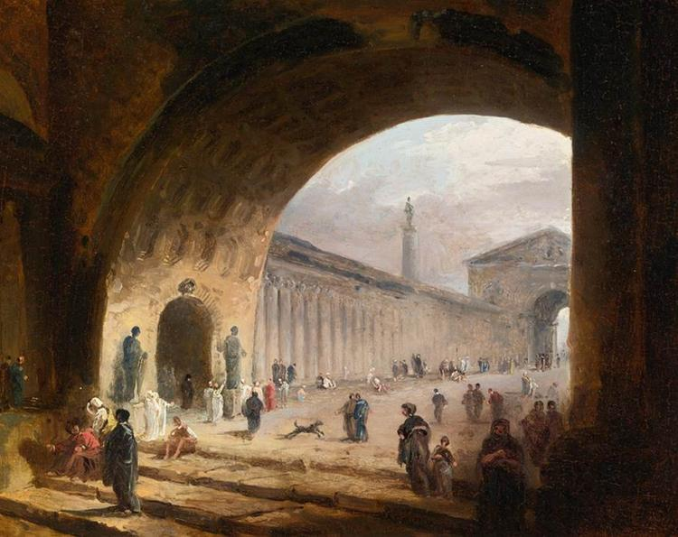
Hubert Robert: The Great Archway, - Oil on panel, 20 x 25 cm Private collection

Slide 48
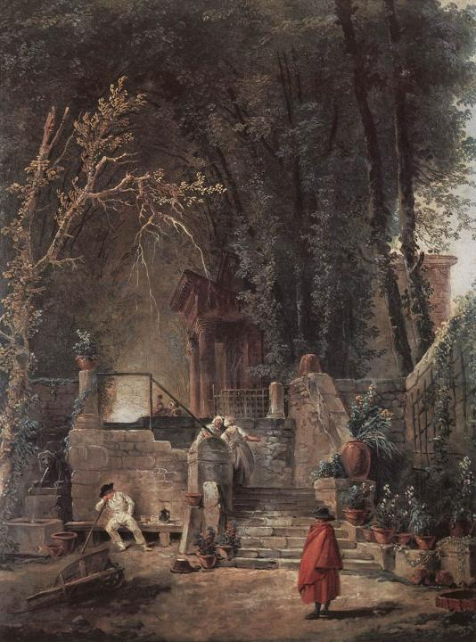
Hubert Robert
Italian Park - Oil on wood
46 x 37 cm Museu Calouste Gulbenkian, Lisbon

Slide 49
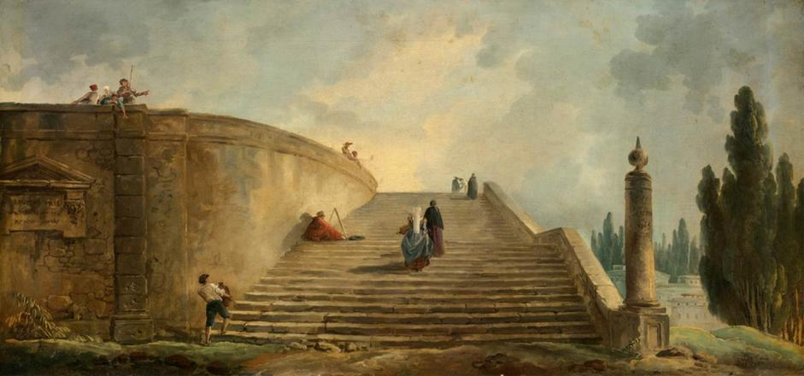
Hubert Robert: A Grand Staircase, 1763, Oil on canvas, 40 x 84 cm Private collection

Slide 50
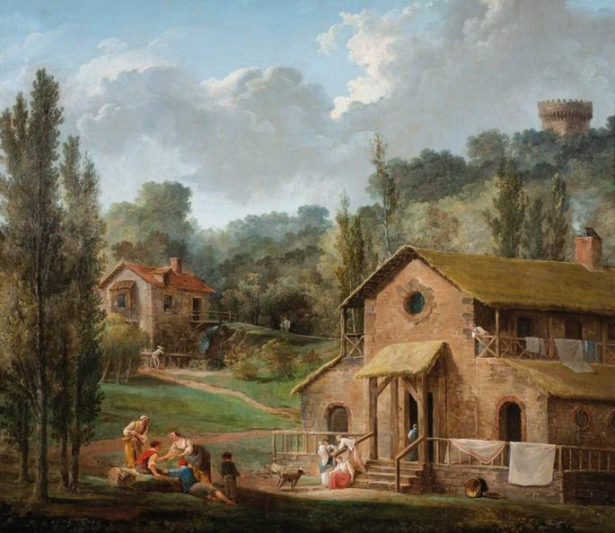
Hubert Robert: Washerwomen in an Imaginary Landscape - Oil on canvas, 96 x 111 cm, Private collection

Slide 51
Hubert Robert: Ancient Roman Bath with Women Washing Laundry
- Oil on canvas, 50 x 61 cm, Private collection

Slide 52
Hubert Robert
Stairway of Farnese Palace Park oil on canvas
217 x 149 cm
National Museum of Serbia Belgrade

Slide 53
Hubert Robert: Stairway of Farnese Palace Park, (detail), oil on canvas
217 x 149 cm, National Museum of Serbia, Belgrade

Slide 54
GRAFIKA

Slide 55
Hubert Robert: The Oval Fountain in the Gardens of the Villa d'Este, Tivoli, 1760, red chalk over graphite oWashington DCn laid paper
32,70 x,45,10 mm National Gallery of Art,

Slide 56
Hubert Robert: Landscape with Ruins, 1772, Pen and brown ink and brush and brown and blue washes, over black chalk, 57,2 × 78,1 cm Getty Center Los Angeles

Slide 57
Hubert Robert
The Draughtsman of the Borghese Vase c. 1775 Red chalk
365 x 290 mm Musée des Beaux-Arts Valence

Slide 58
Hubert Robert: The Artist Drawing in the Farnese Gardens - Red chalk, 340 x 455 mm, Musée du Louvre, Paris

Slide 59
Hubert Robert: Ditch at Place de la Concorde - Red chalk, 360 x 480 mm, Musée Carnavalet, Paris

